Slide 1
Predictable Elections, Ideological Constraint, and Stability in the 21st Century
Jonathan R. Cervas
University of California Irvine

Slide 2
Puzzle
Pundits, politicians, and consultants sell us on the idea that American Presidential Elections are competitive
Independents and weak partisans have increased at the expense of strong partisans
I will show evidence that Presidential elections are more stable and predictable now than in previous decades despite this.

Slide 3
Research Questions
Are presidential elections more stable now than they were in the past?

Slide 4
Micro-Level
In the 1960s, researchers found voters to hold inconsistent policy preferences and lacked ideological constraint.
More recent research determined that Americans now have more consistent ideologies, and that many of the inconsistencies in the early studies were a result of measurement error.

Slide 5
Macro-Level
Geographic regions have become more reliably partisan
States like California no longer swing from election to election

Slide 6
Causal Story
Although the evidence presented here can’t show the cause of stable elections, sorting of both ideologies in the parties and people around the country can explain why the electorate appears to be polarized.
It can also help show why Election outcomes are more predictable.

Slide 7
Micro-Level

Slide 8
Party ID Self Placement

Slide 9
Independents and Leaners

Slide 10
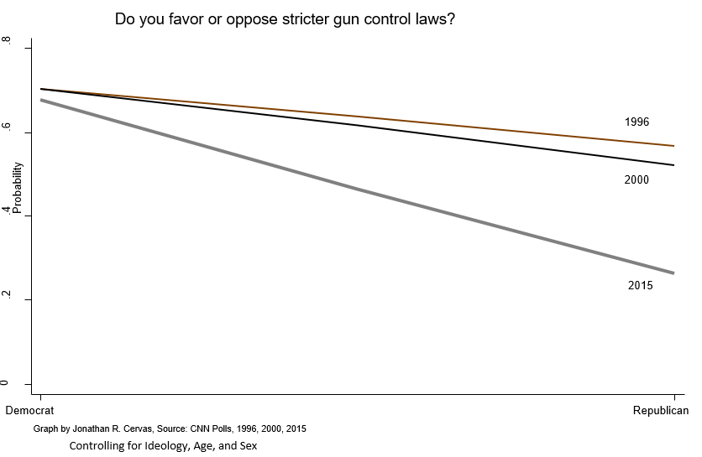
Ideological Sorting

Slide 11
% Voting for Democratic Presidential Candidate

Slide 12
Proportion of Strong Democrats Who Vote Republican in Presidential Election

Slide 13
Probability of Voting for Democratic Presidential Candidate

Slide 14
Probability of Voting for Rpublican Presidential Candidate

Slide 17
Split-ticket Voting?

Slide 18
Macro-Level

Slide 19
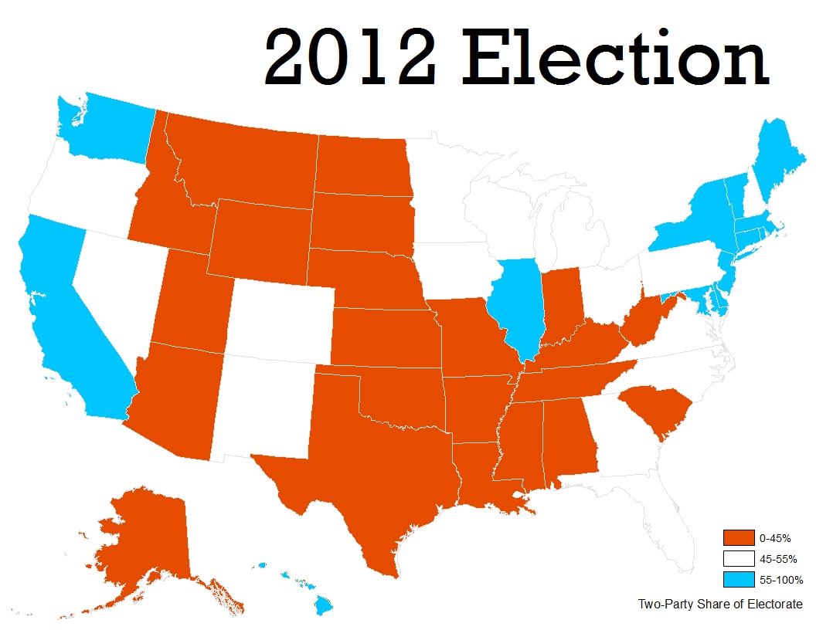

Slide 20
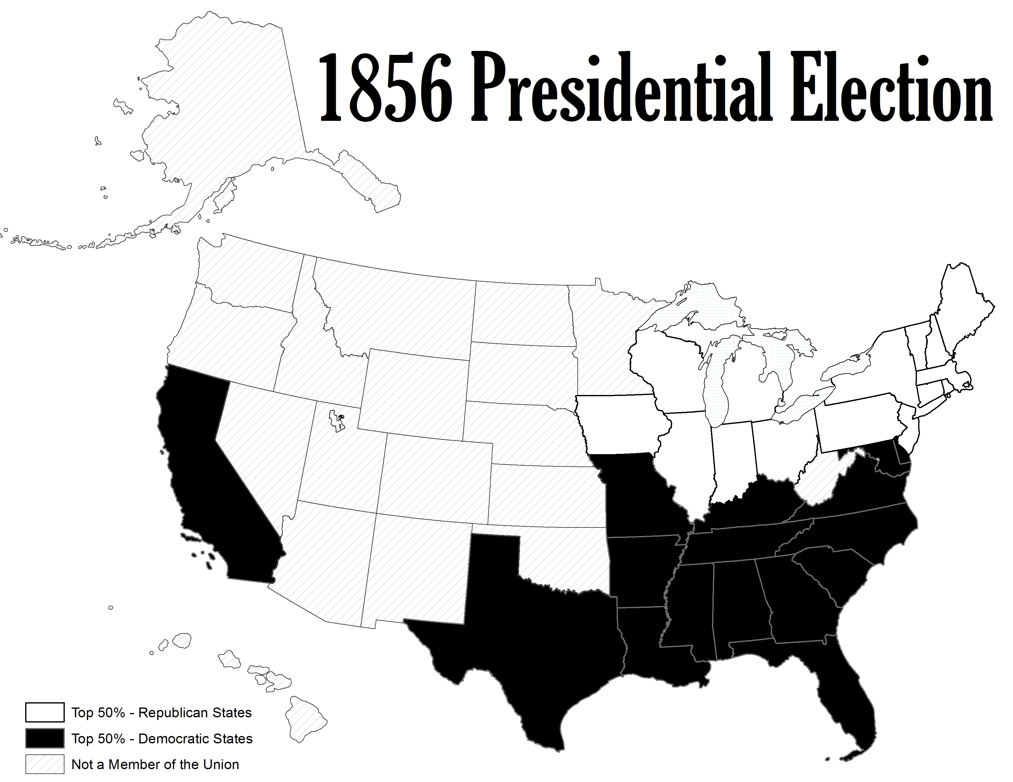

Slide 21


Slide 22
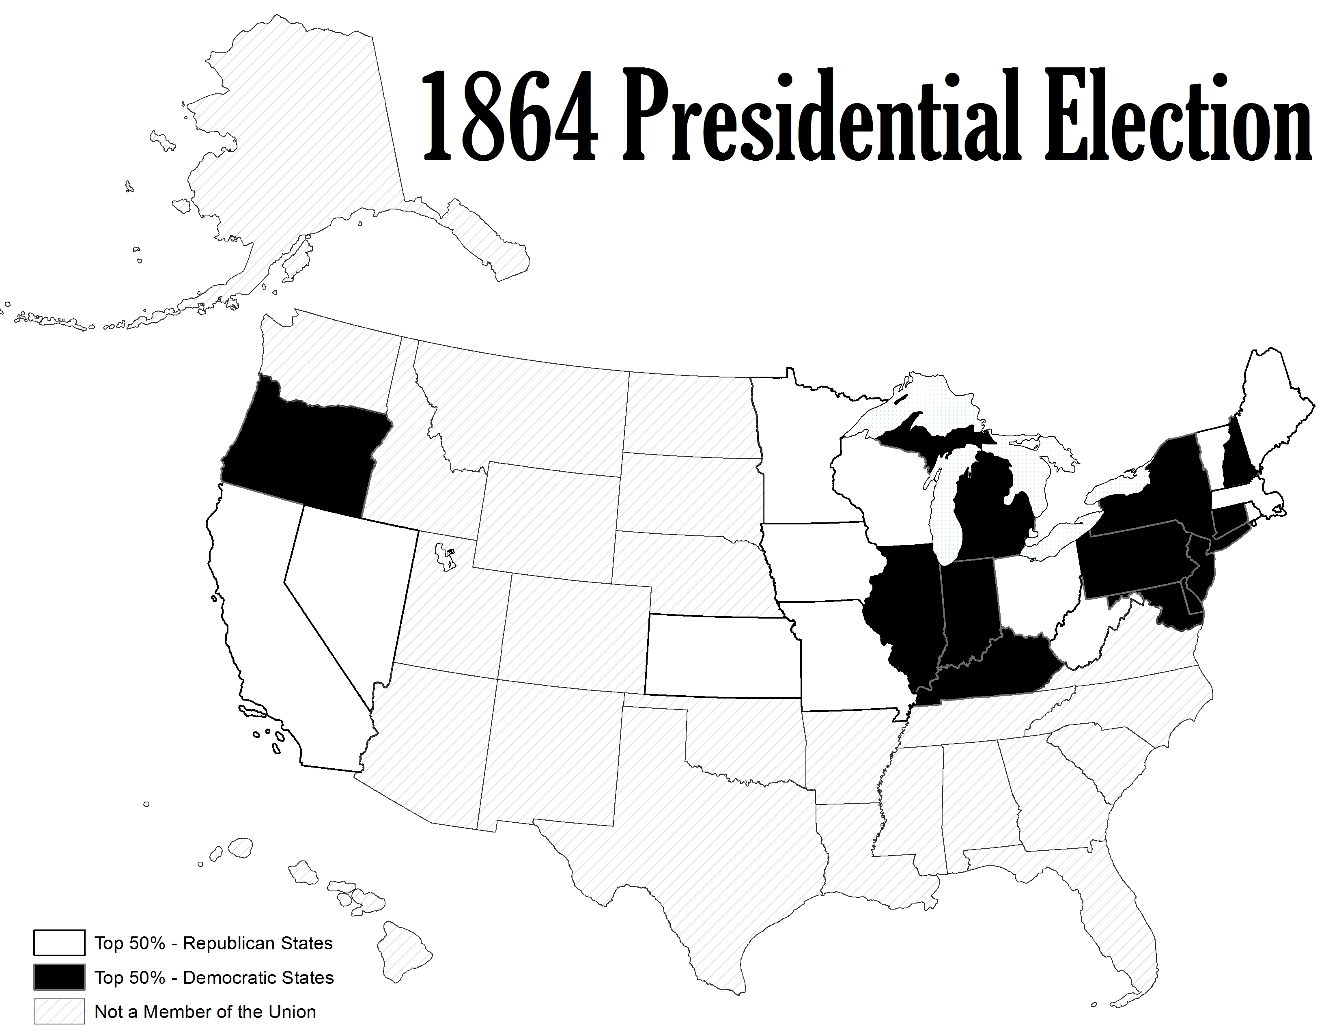

Slide 23
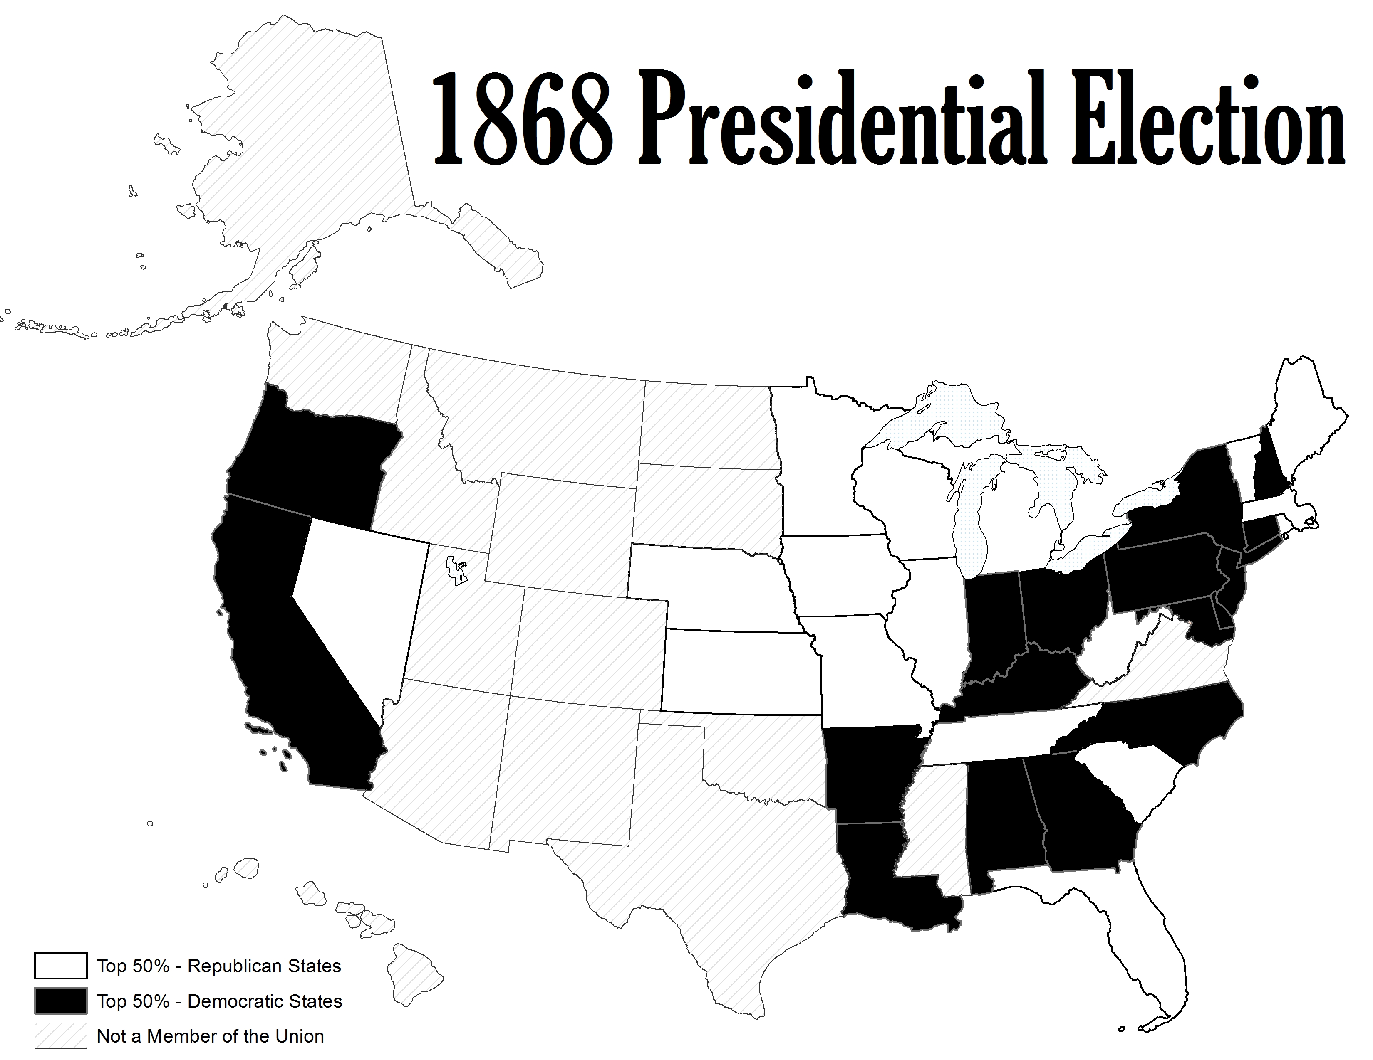

Slide 24
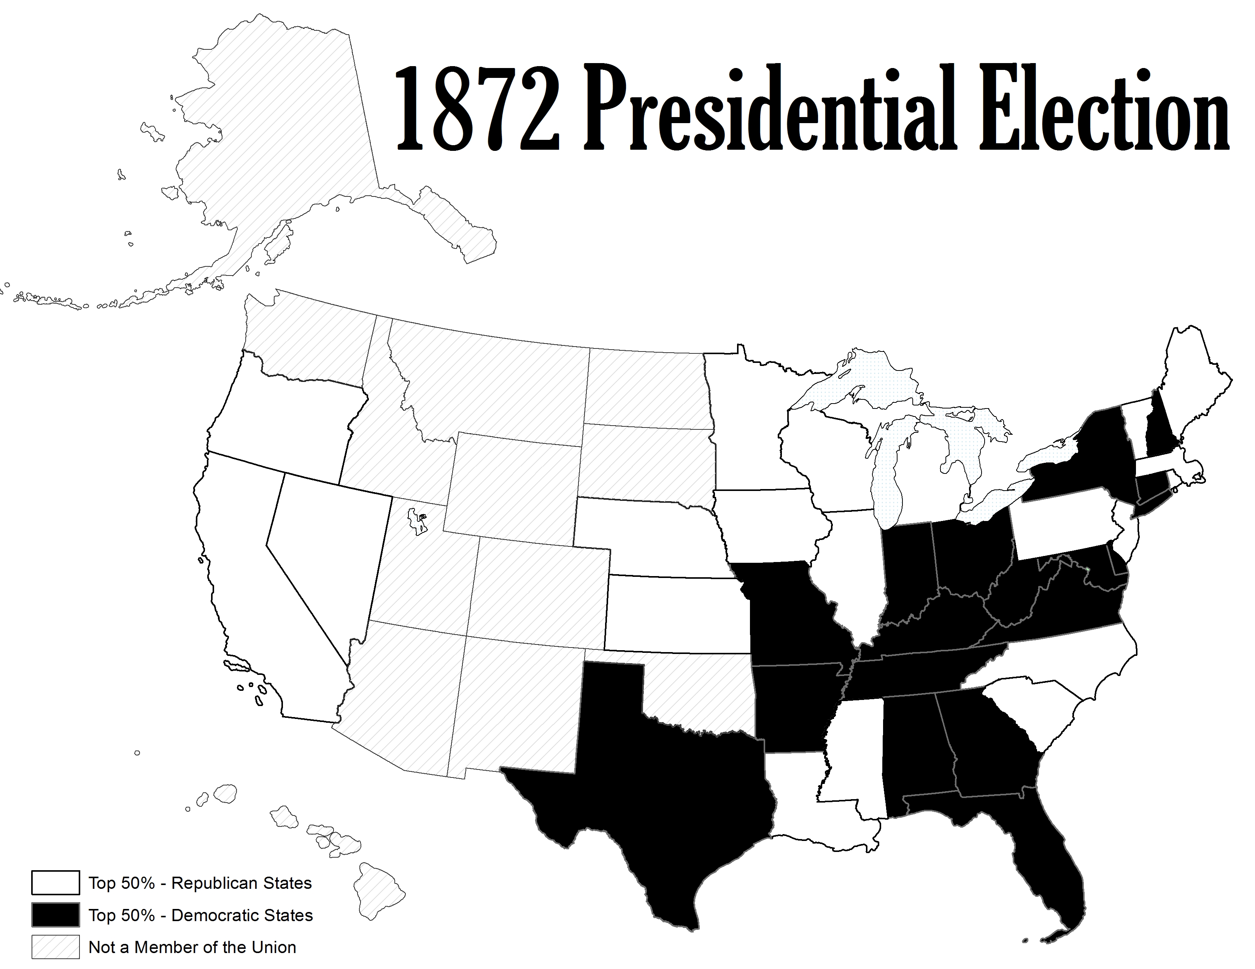

Slide 25
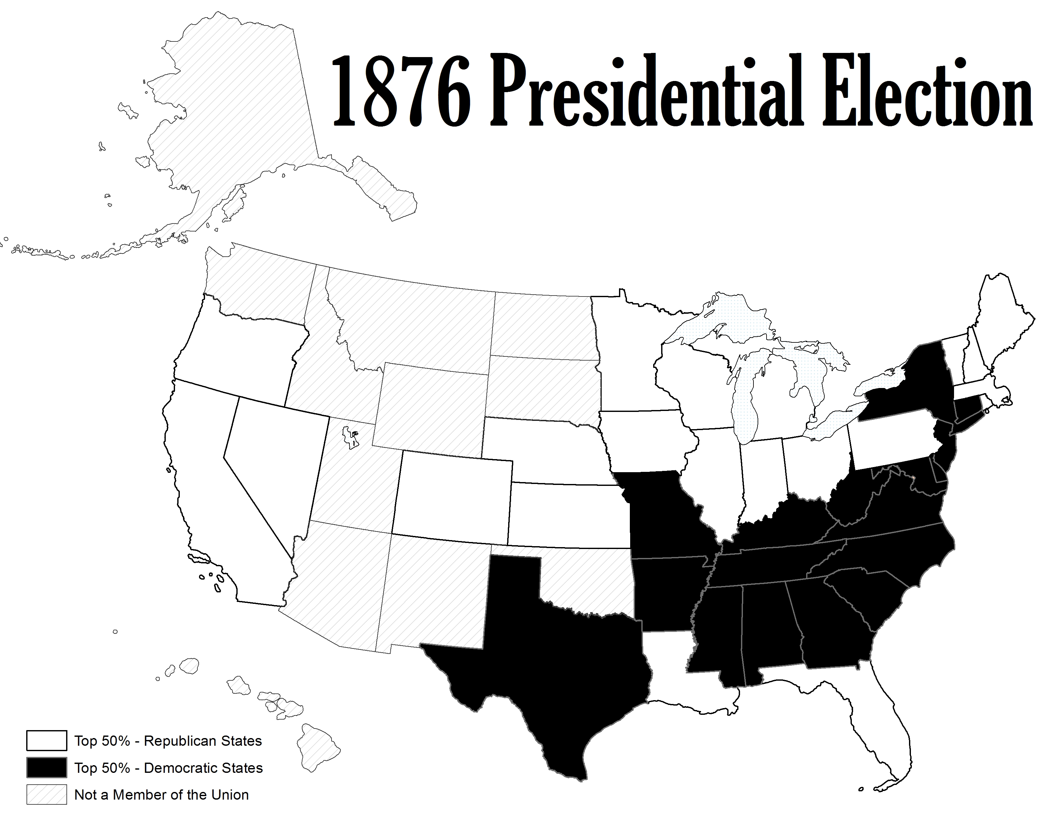

Slide 26
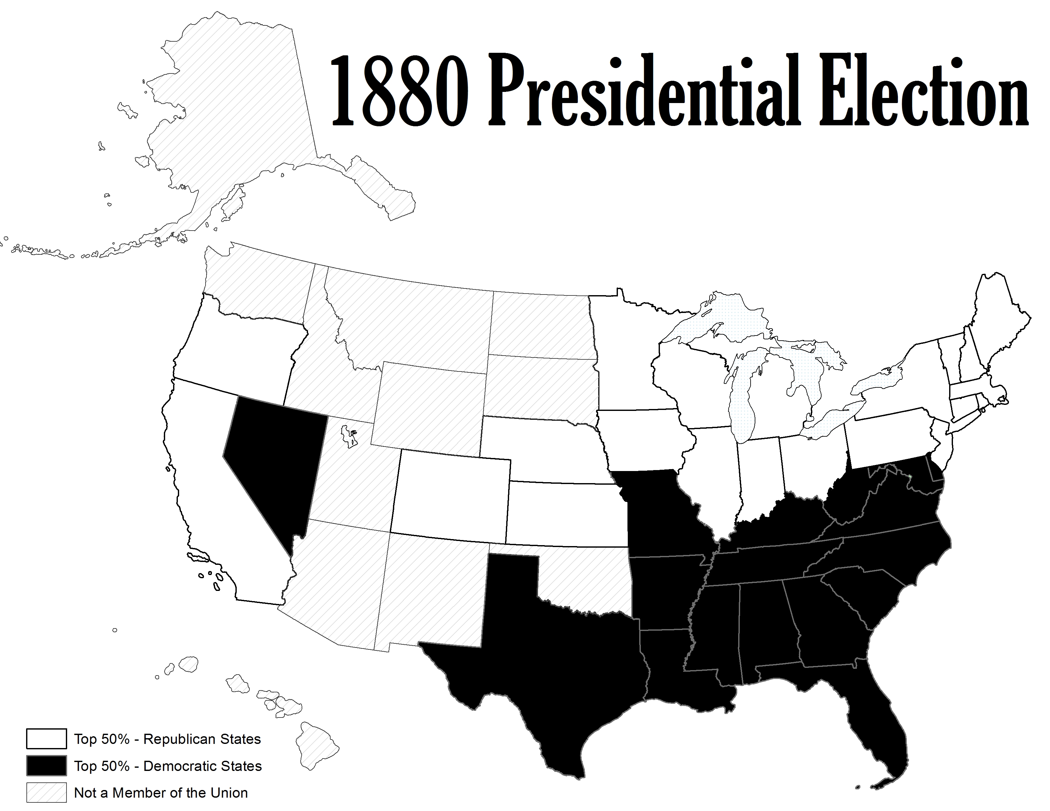

Slide 27
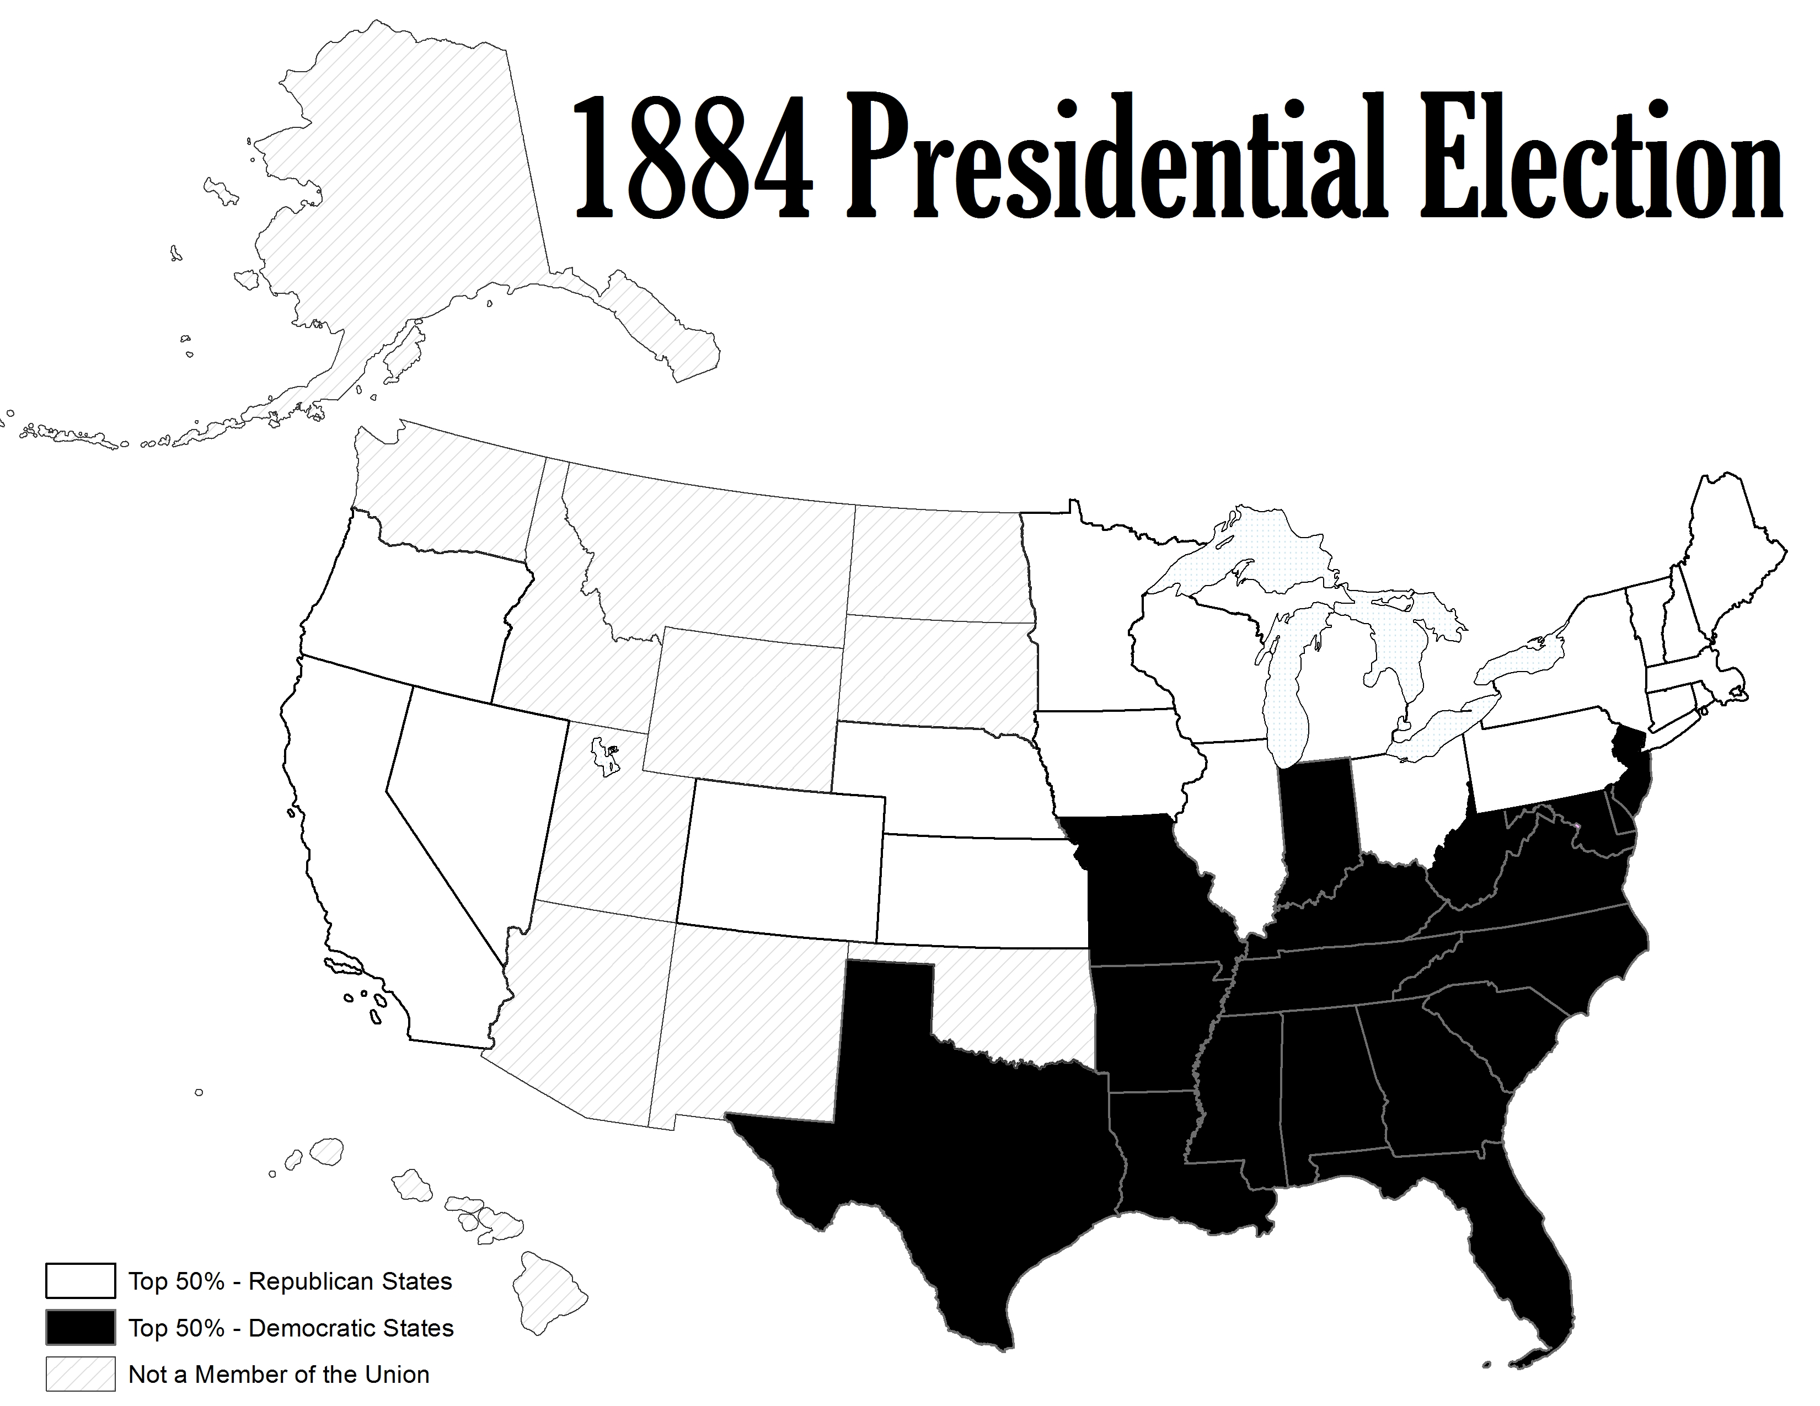

Slide 28
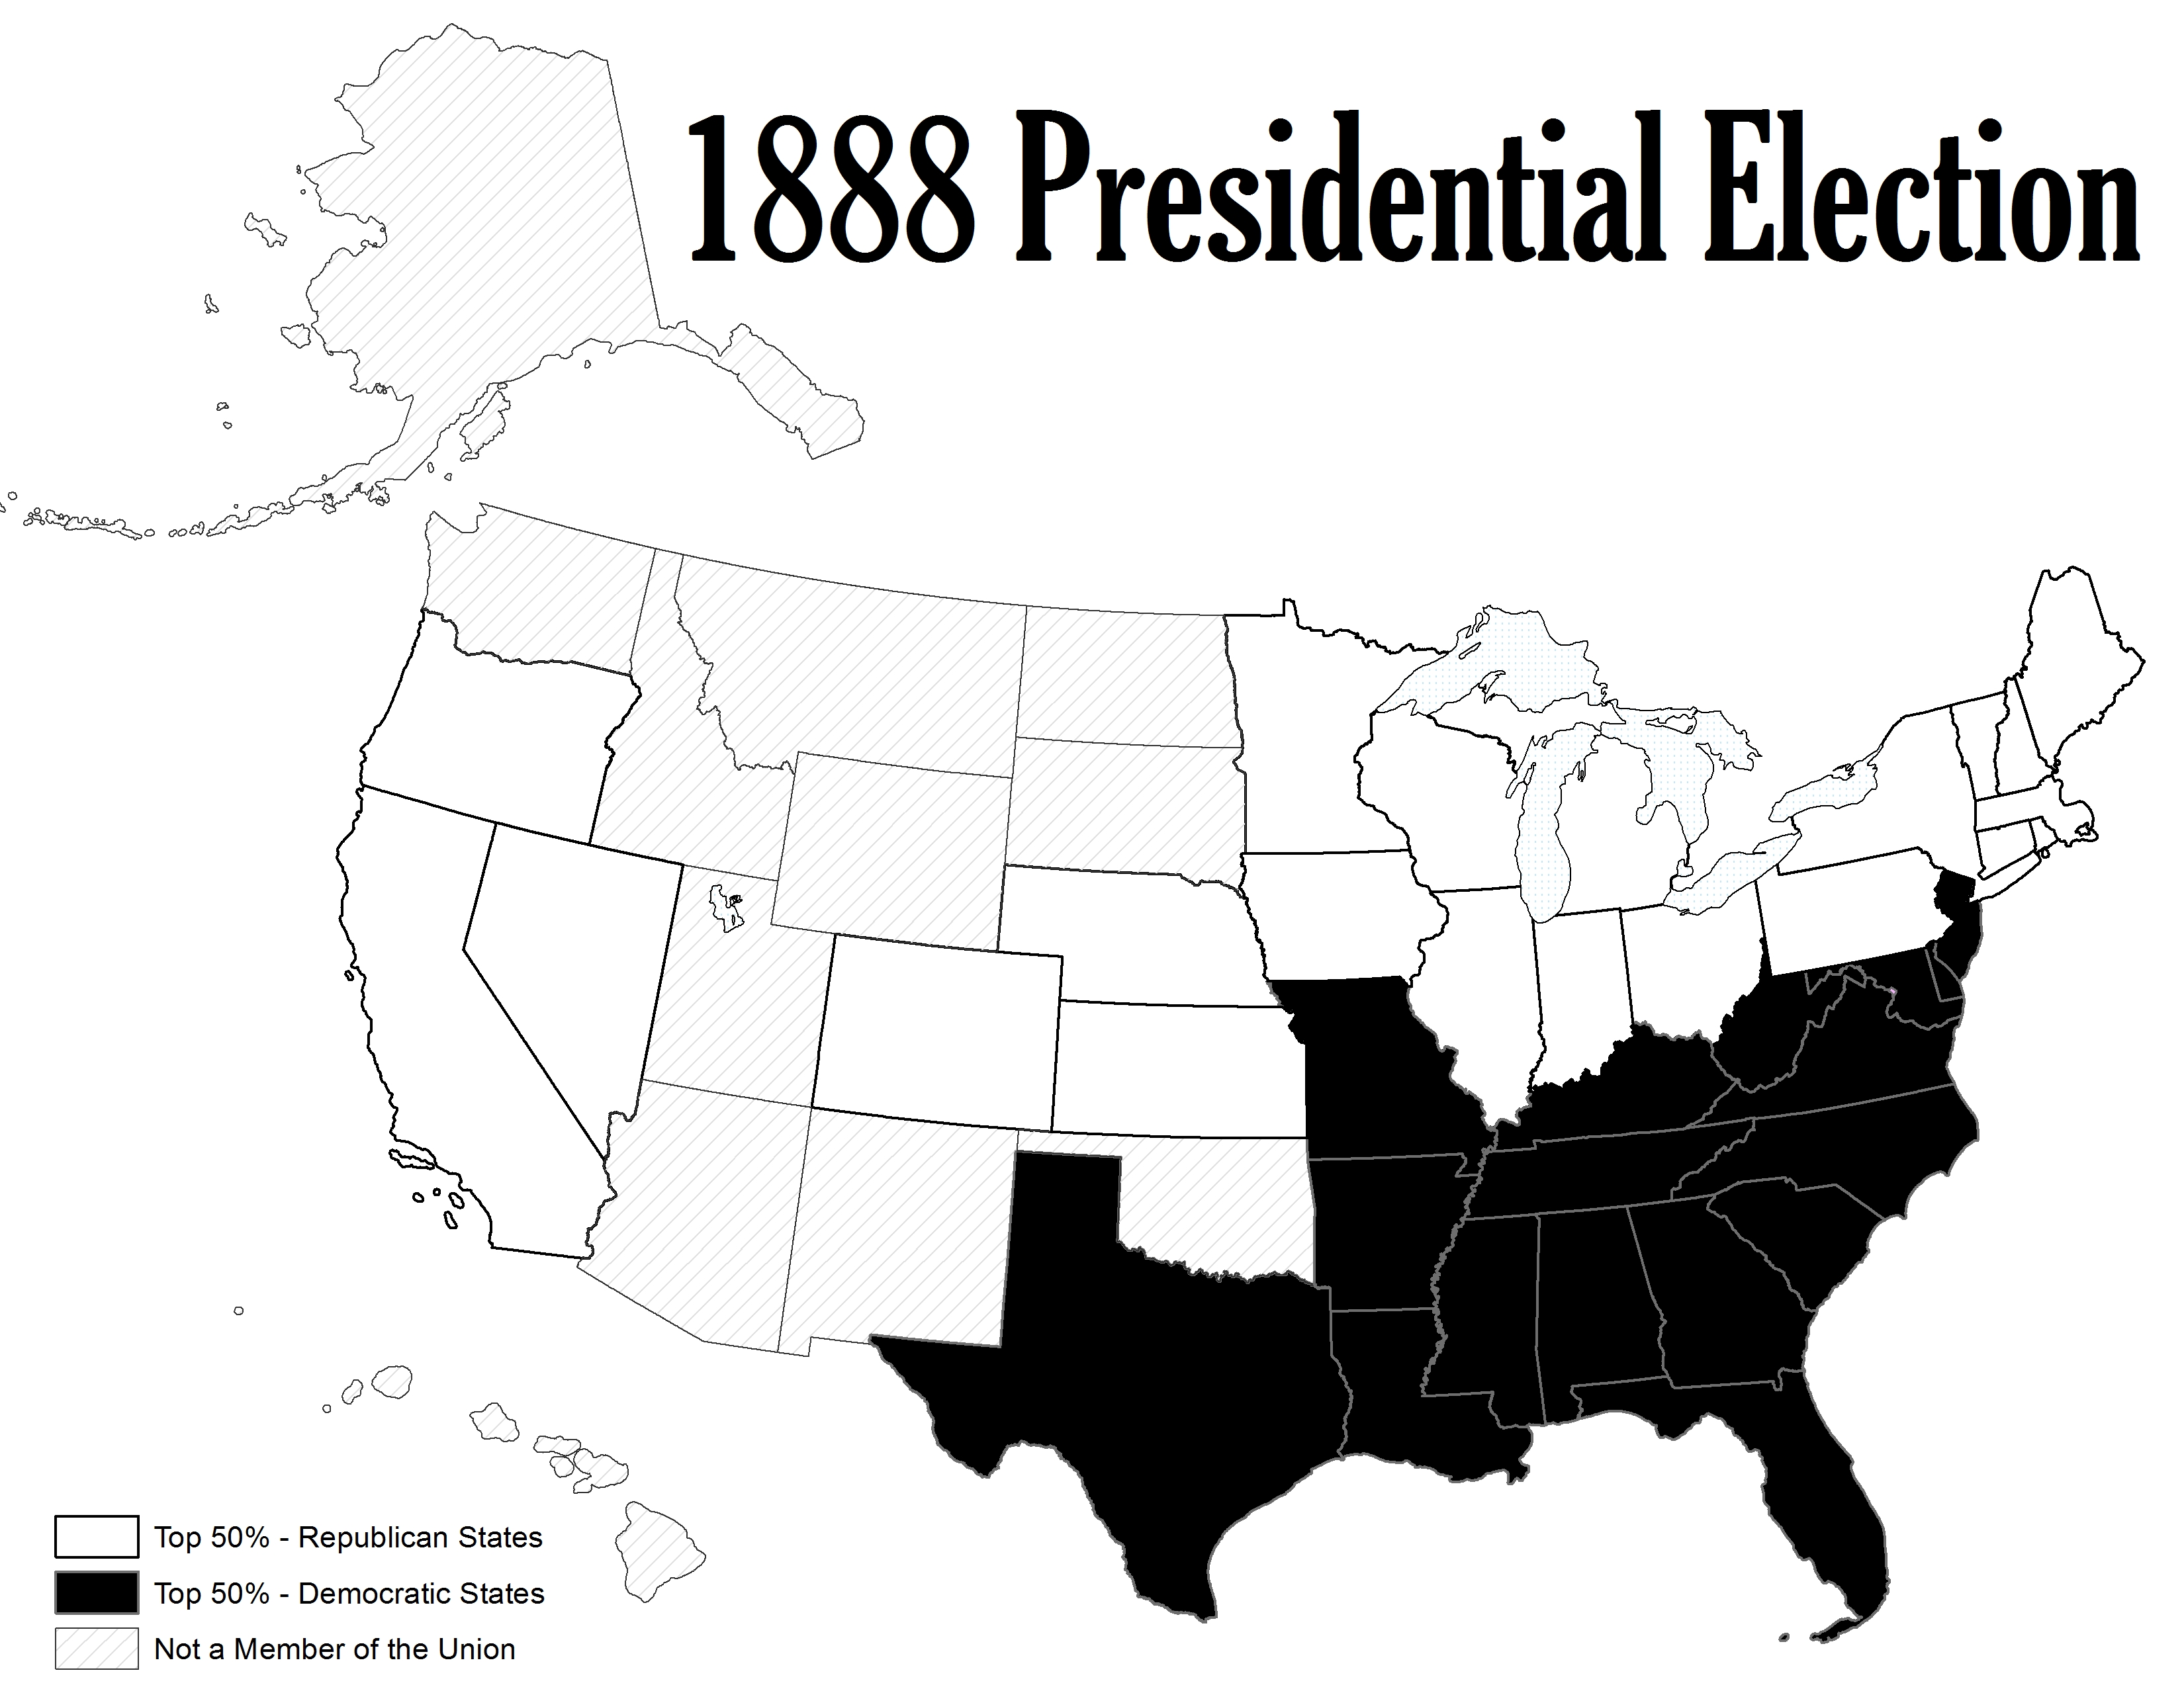

Slide 29
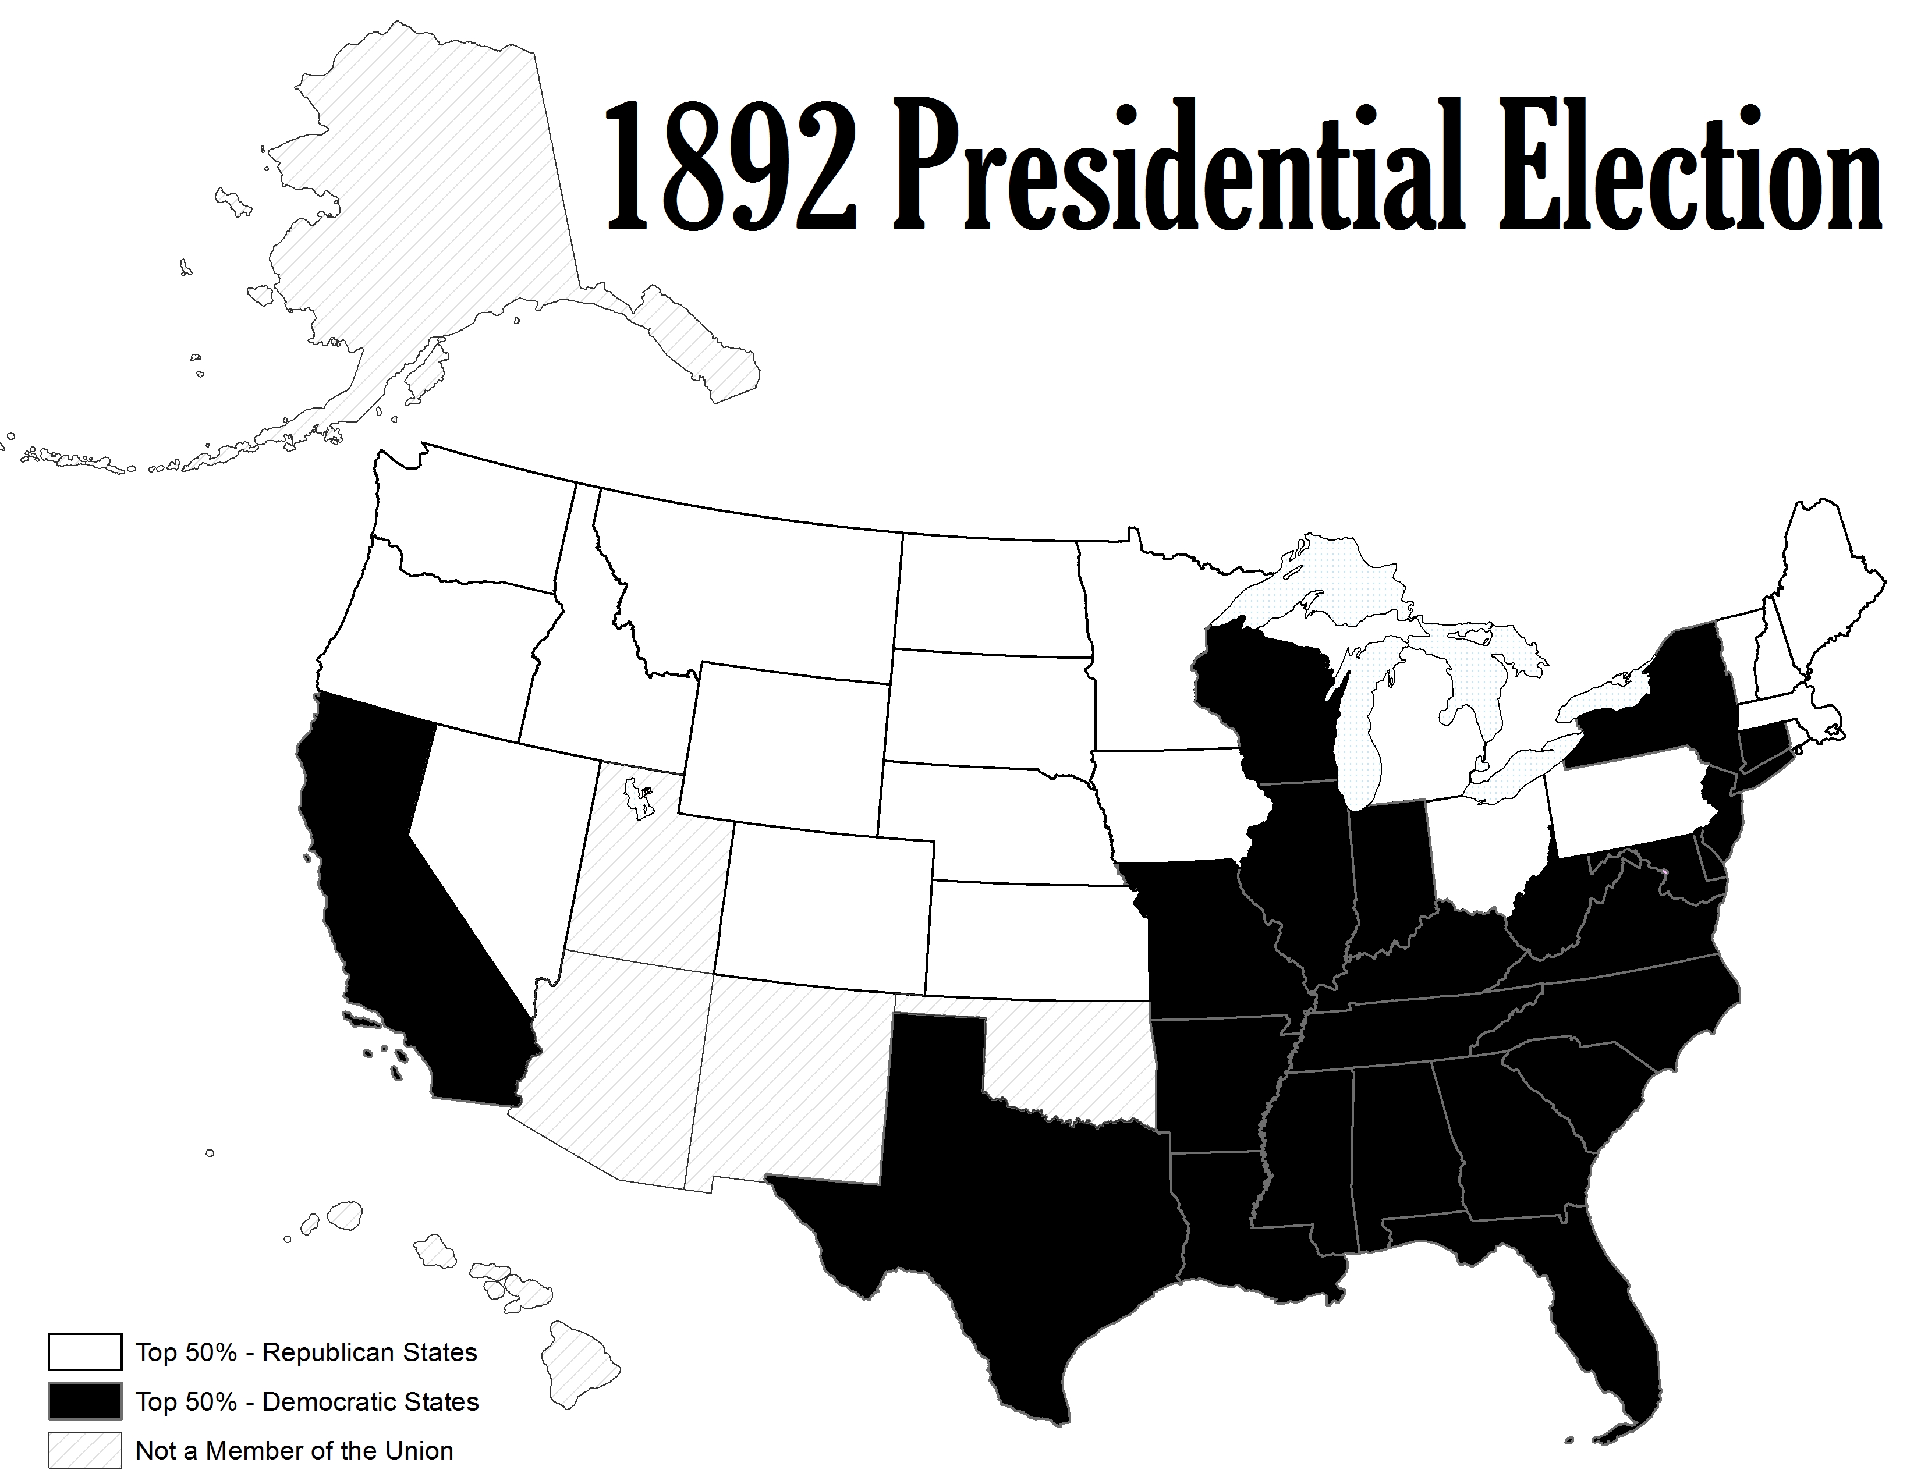

Slide 30
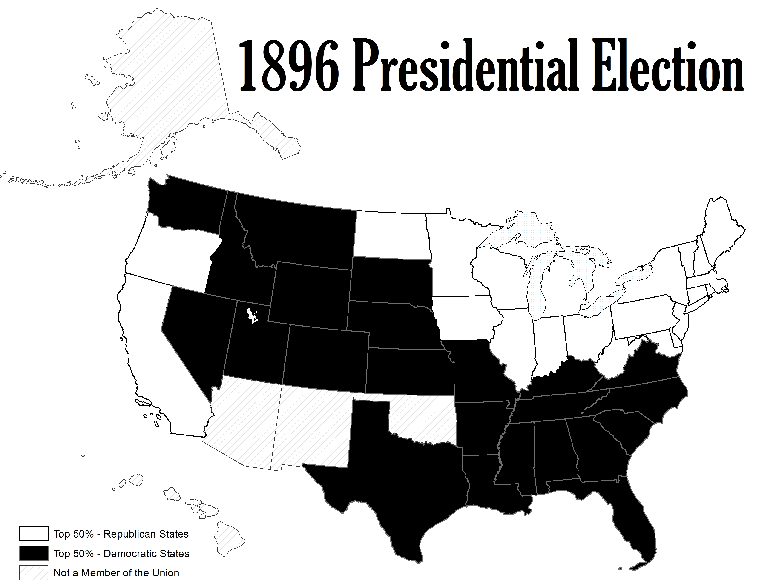

Slide 31
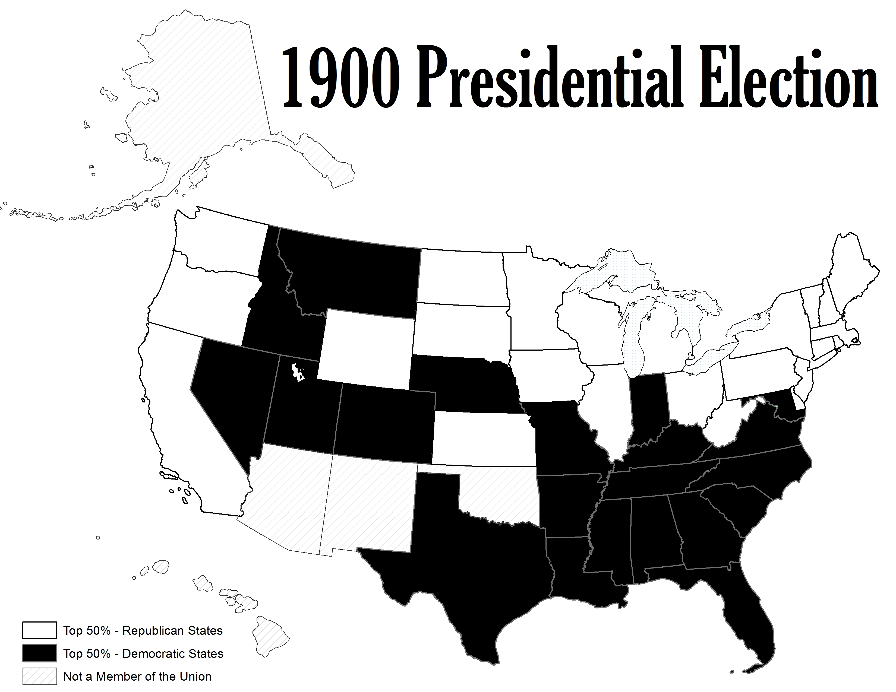

Slide 32
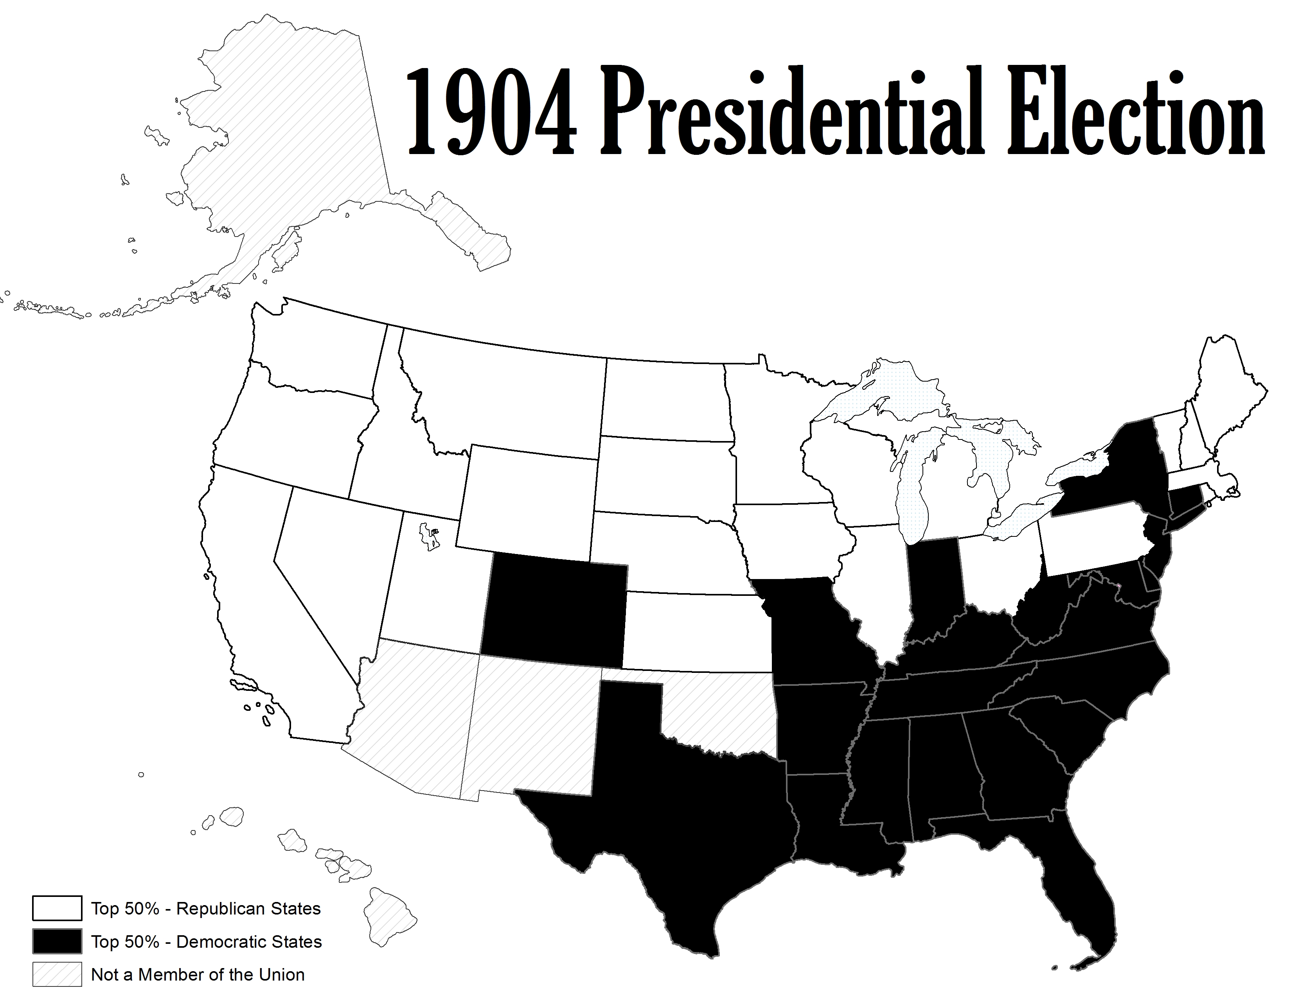

Slide 33
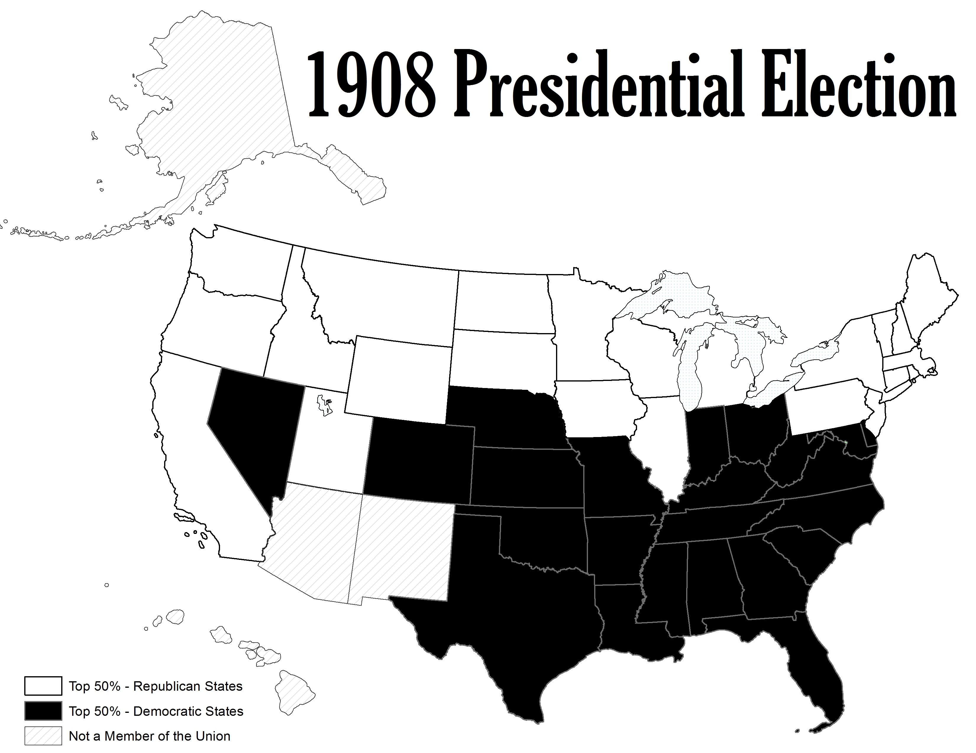

Slide 34
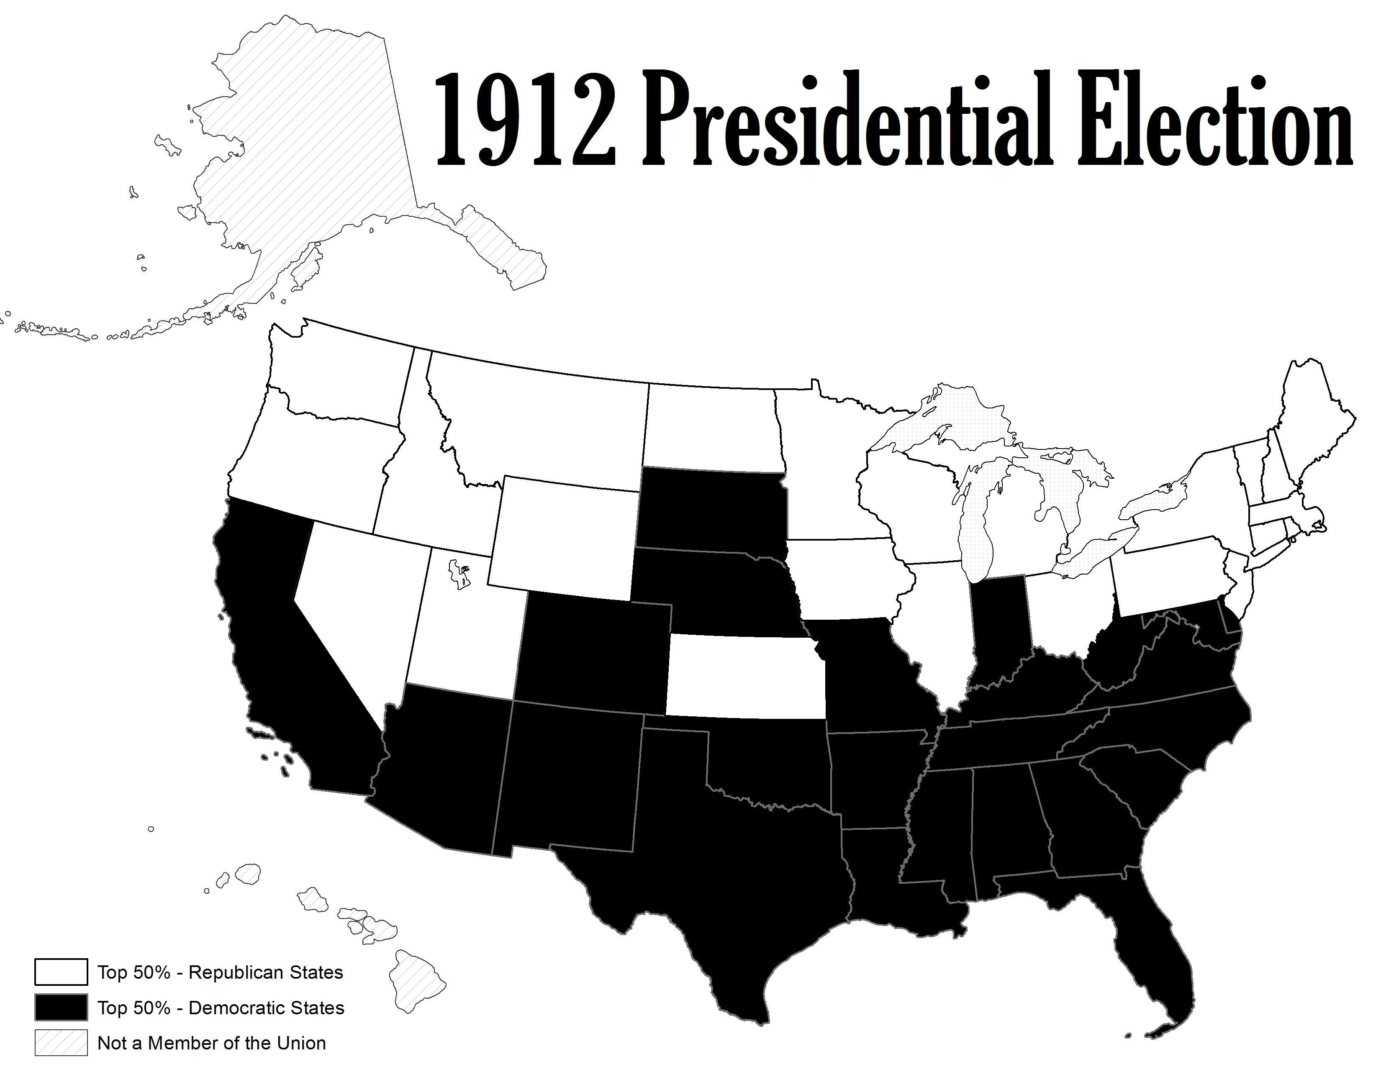

Slide 35
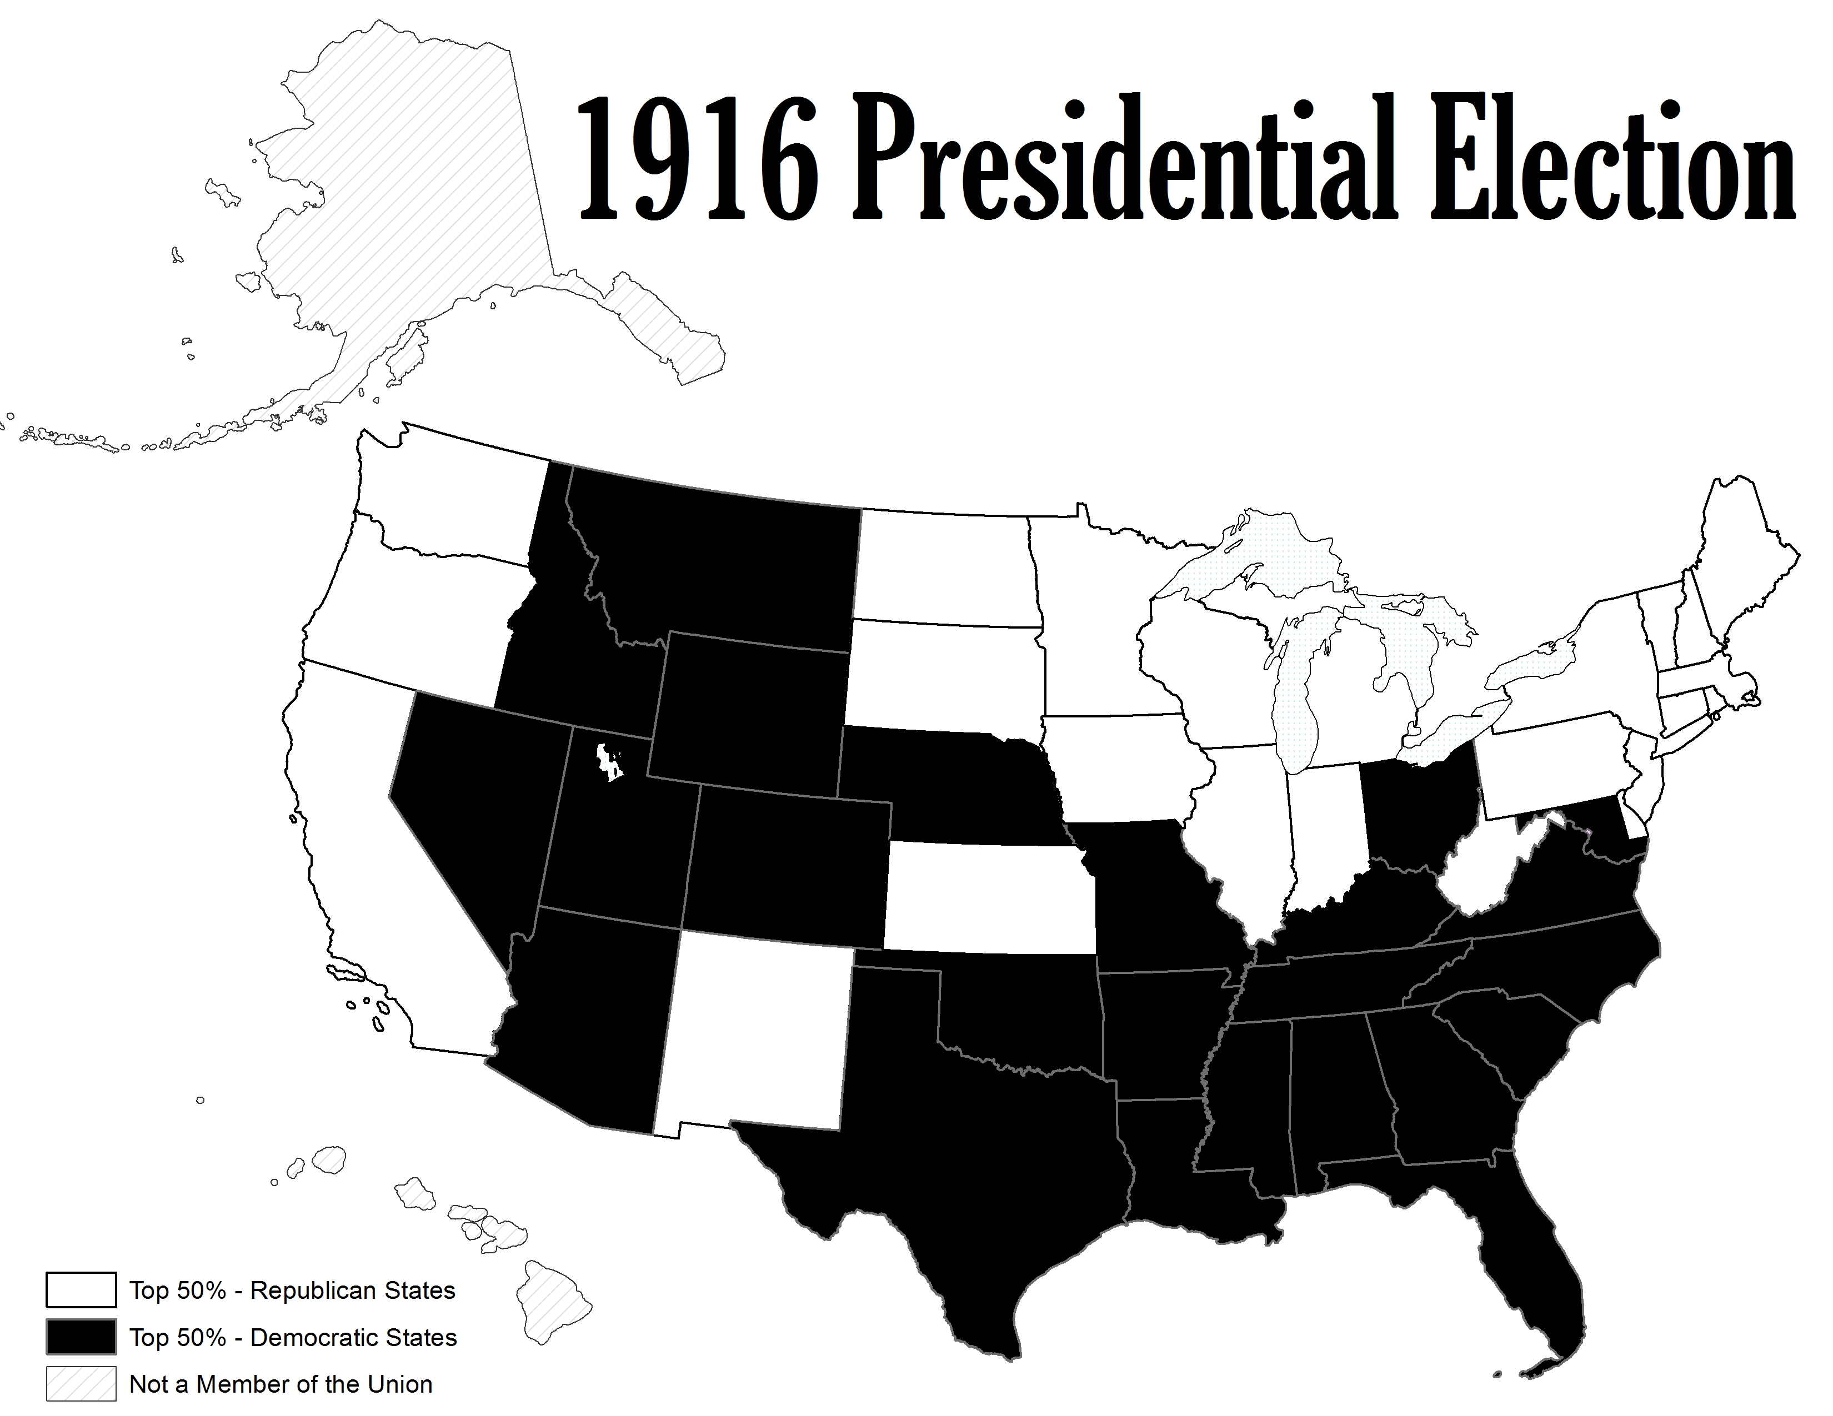

Slide 36
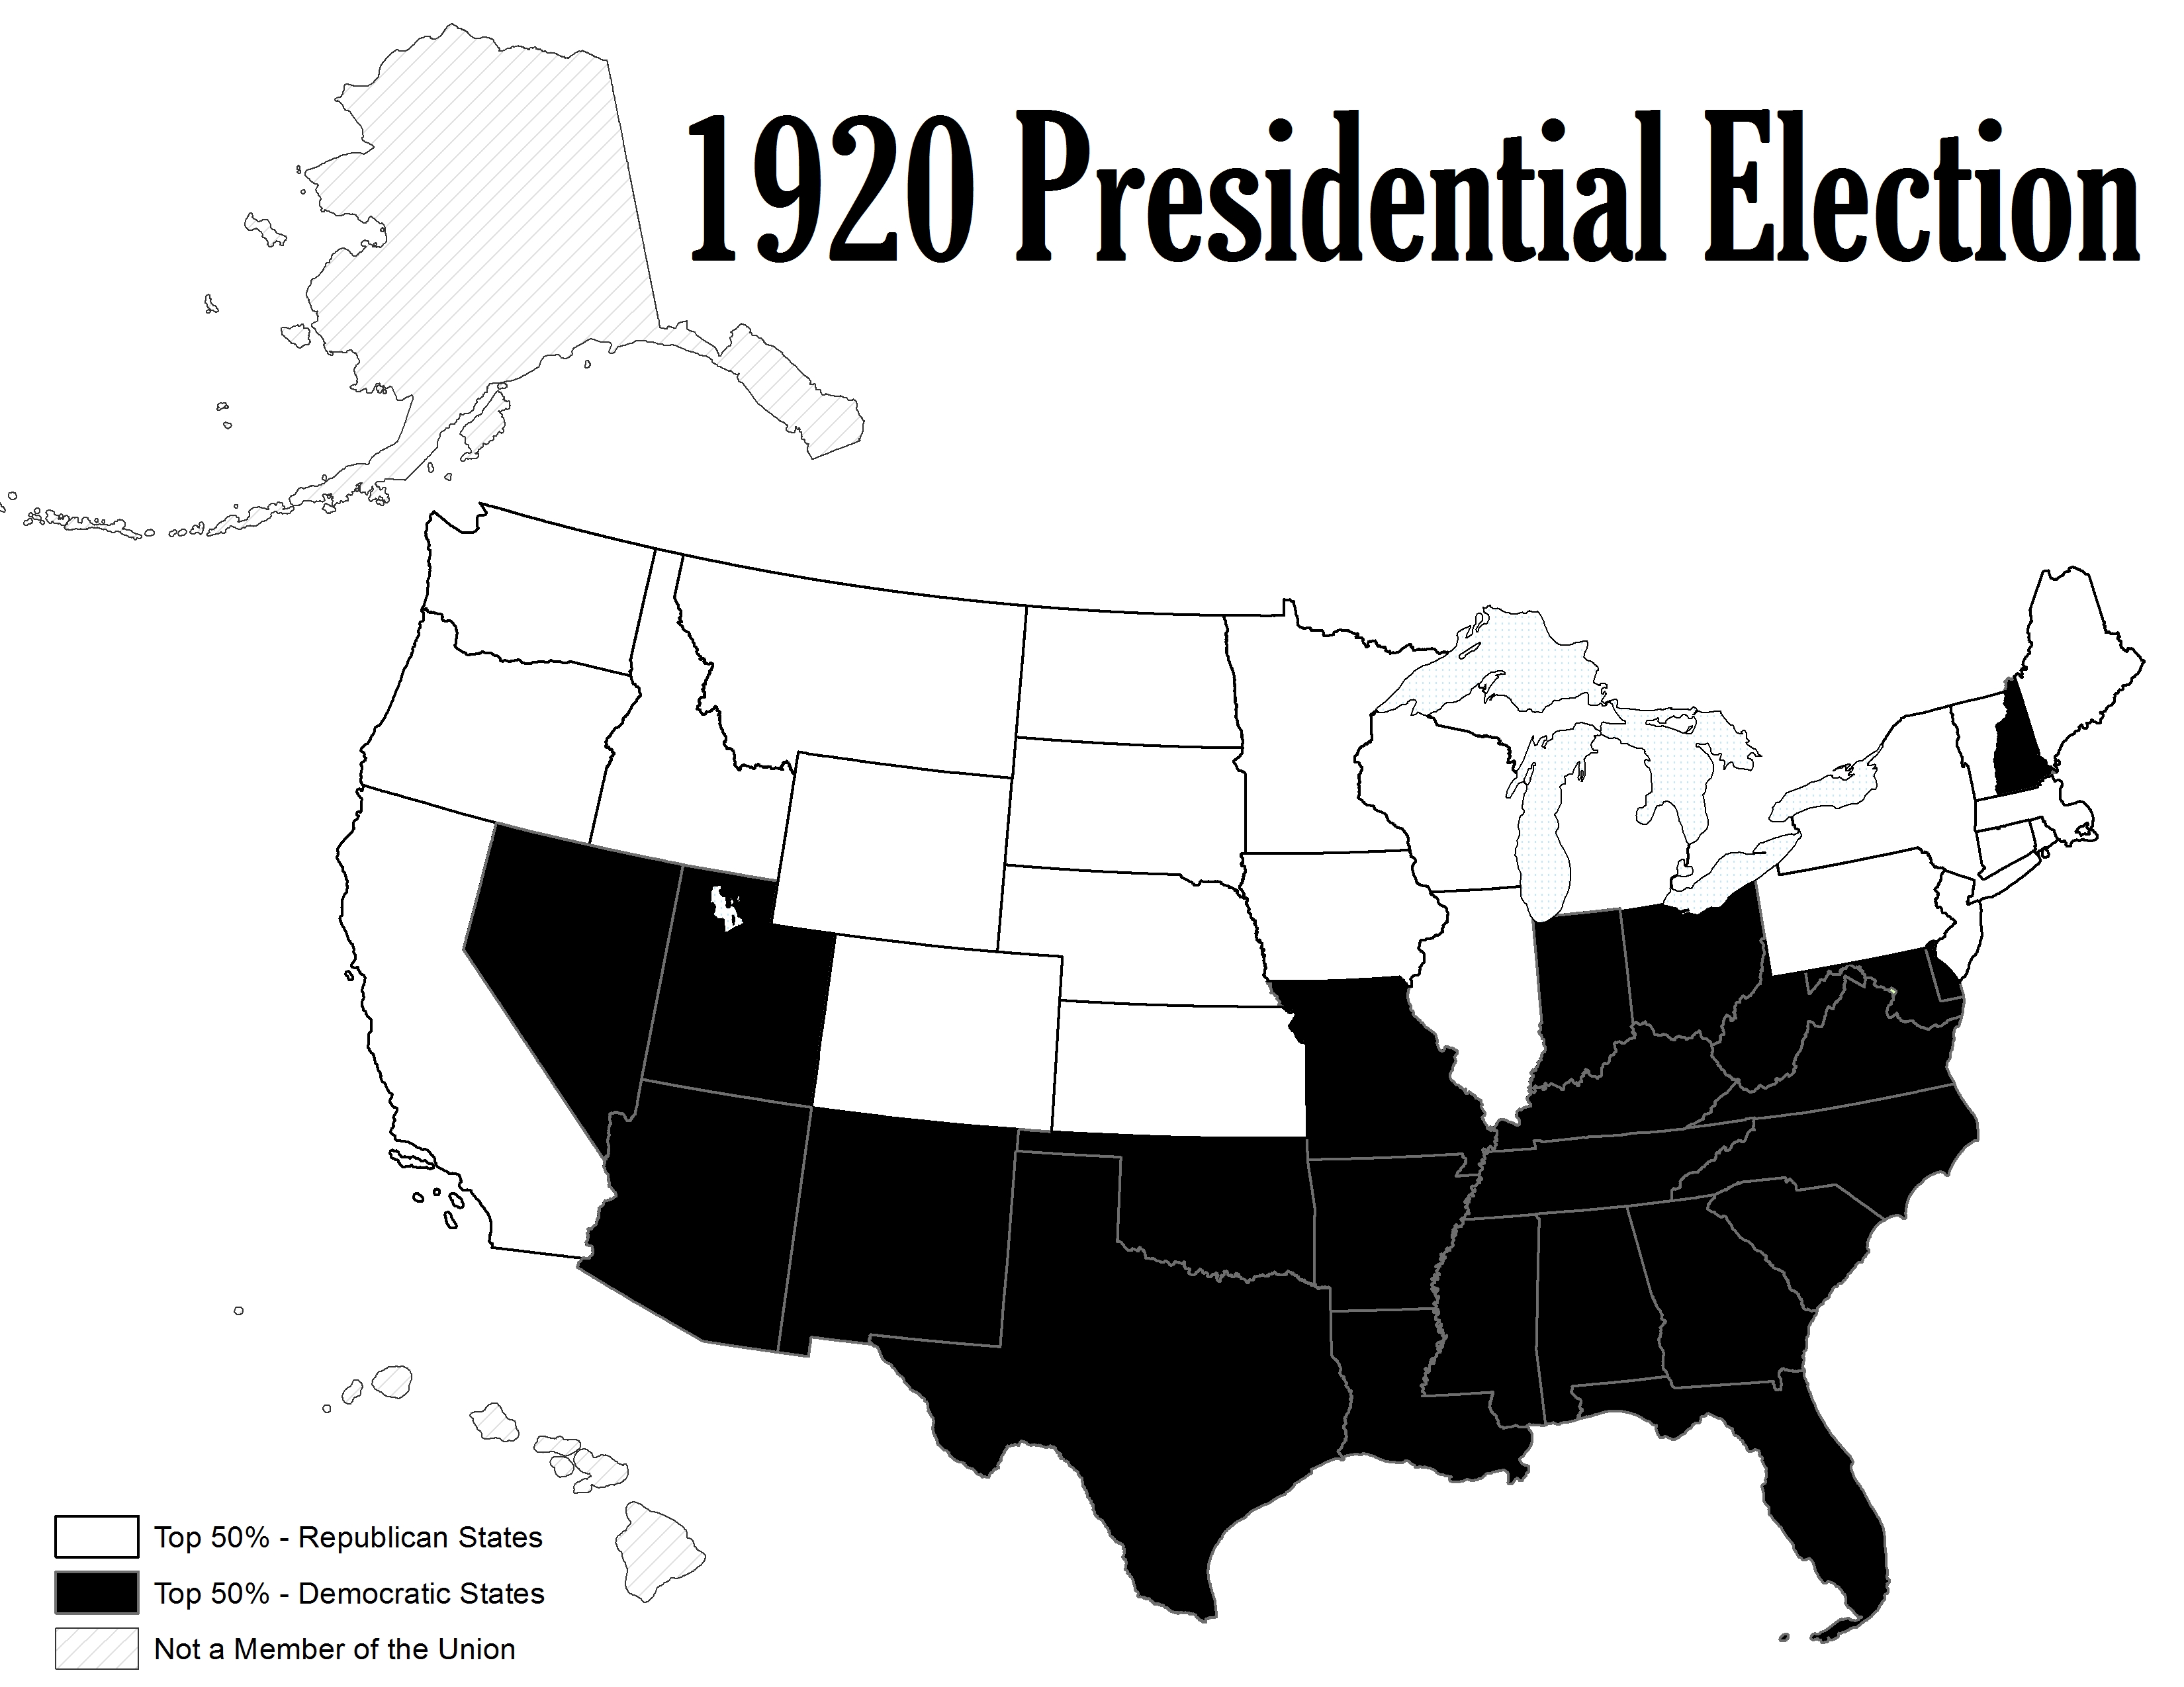

Slide 37
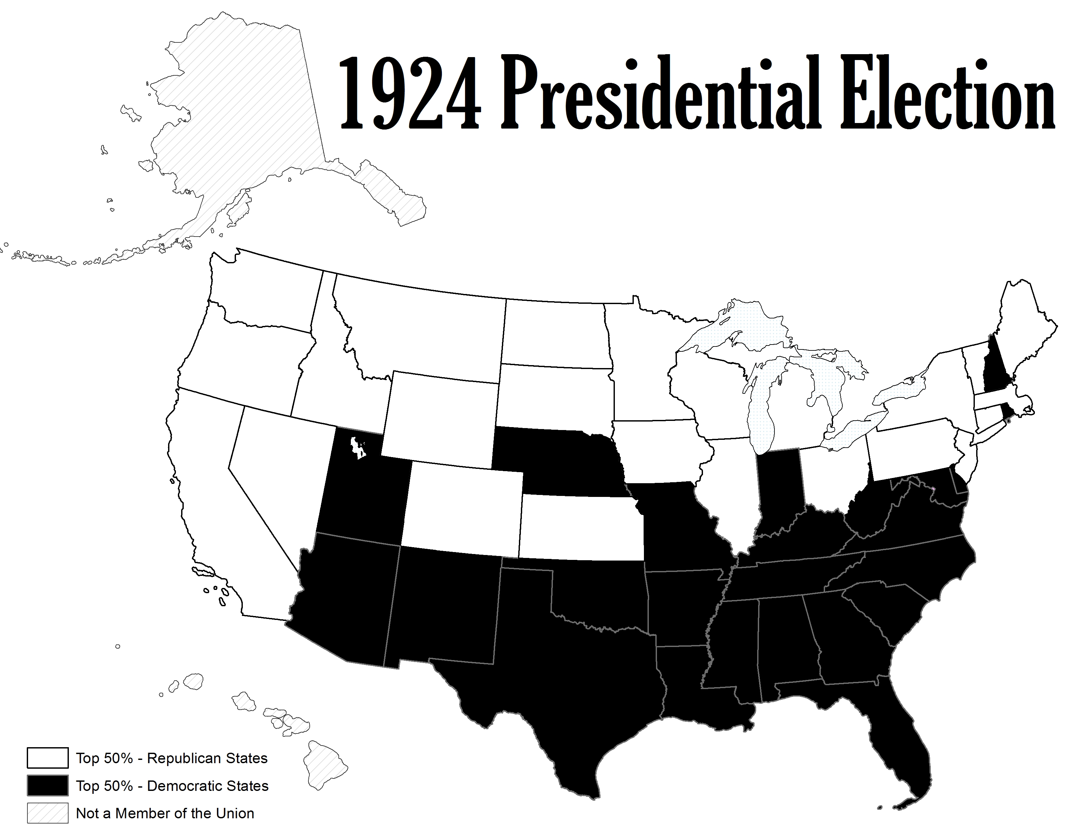

Slide 38
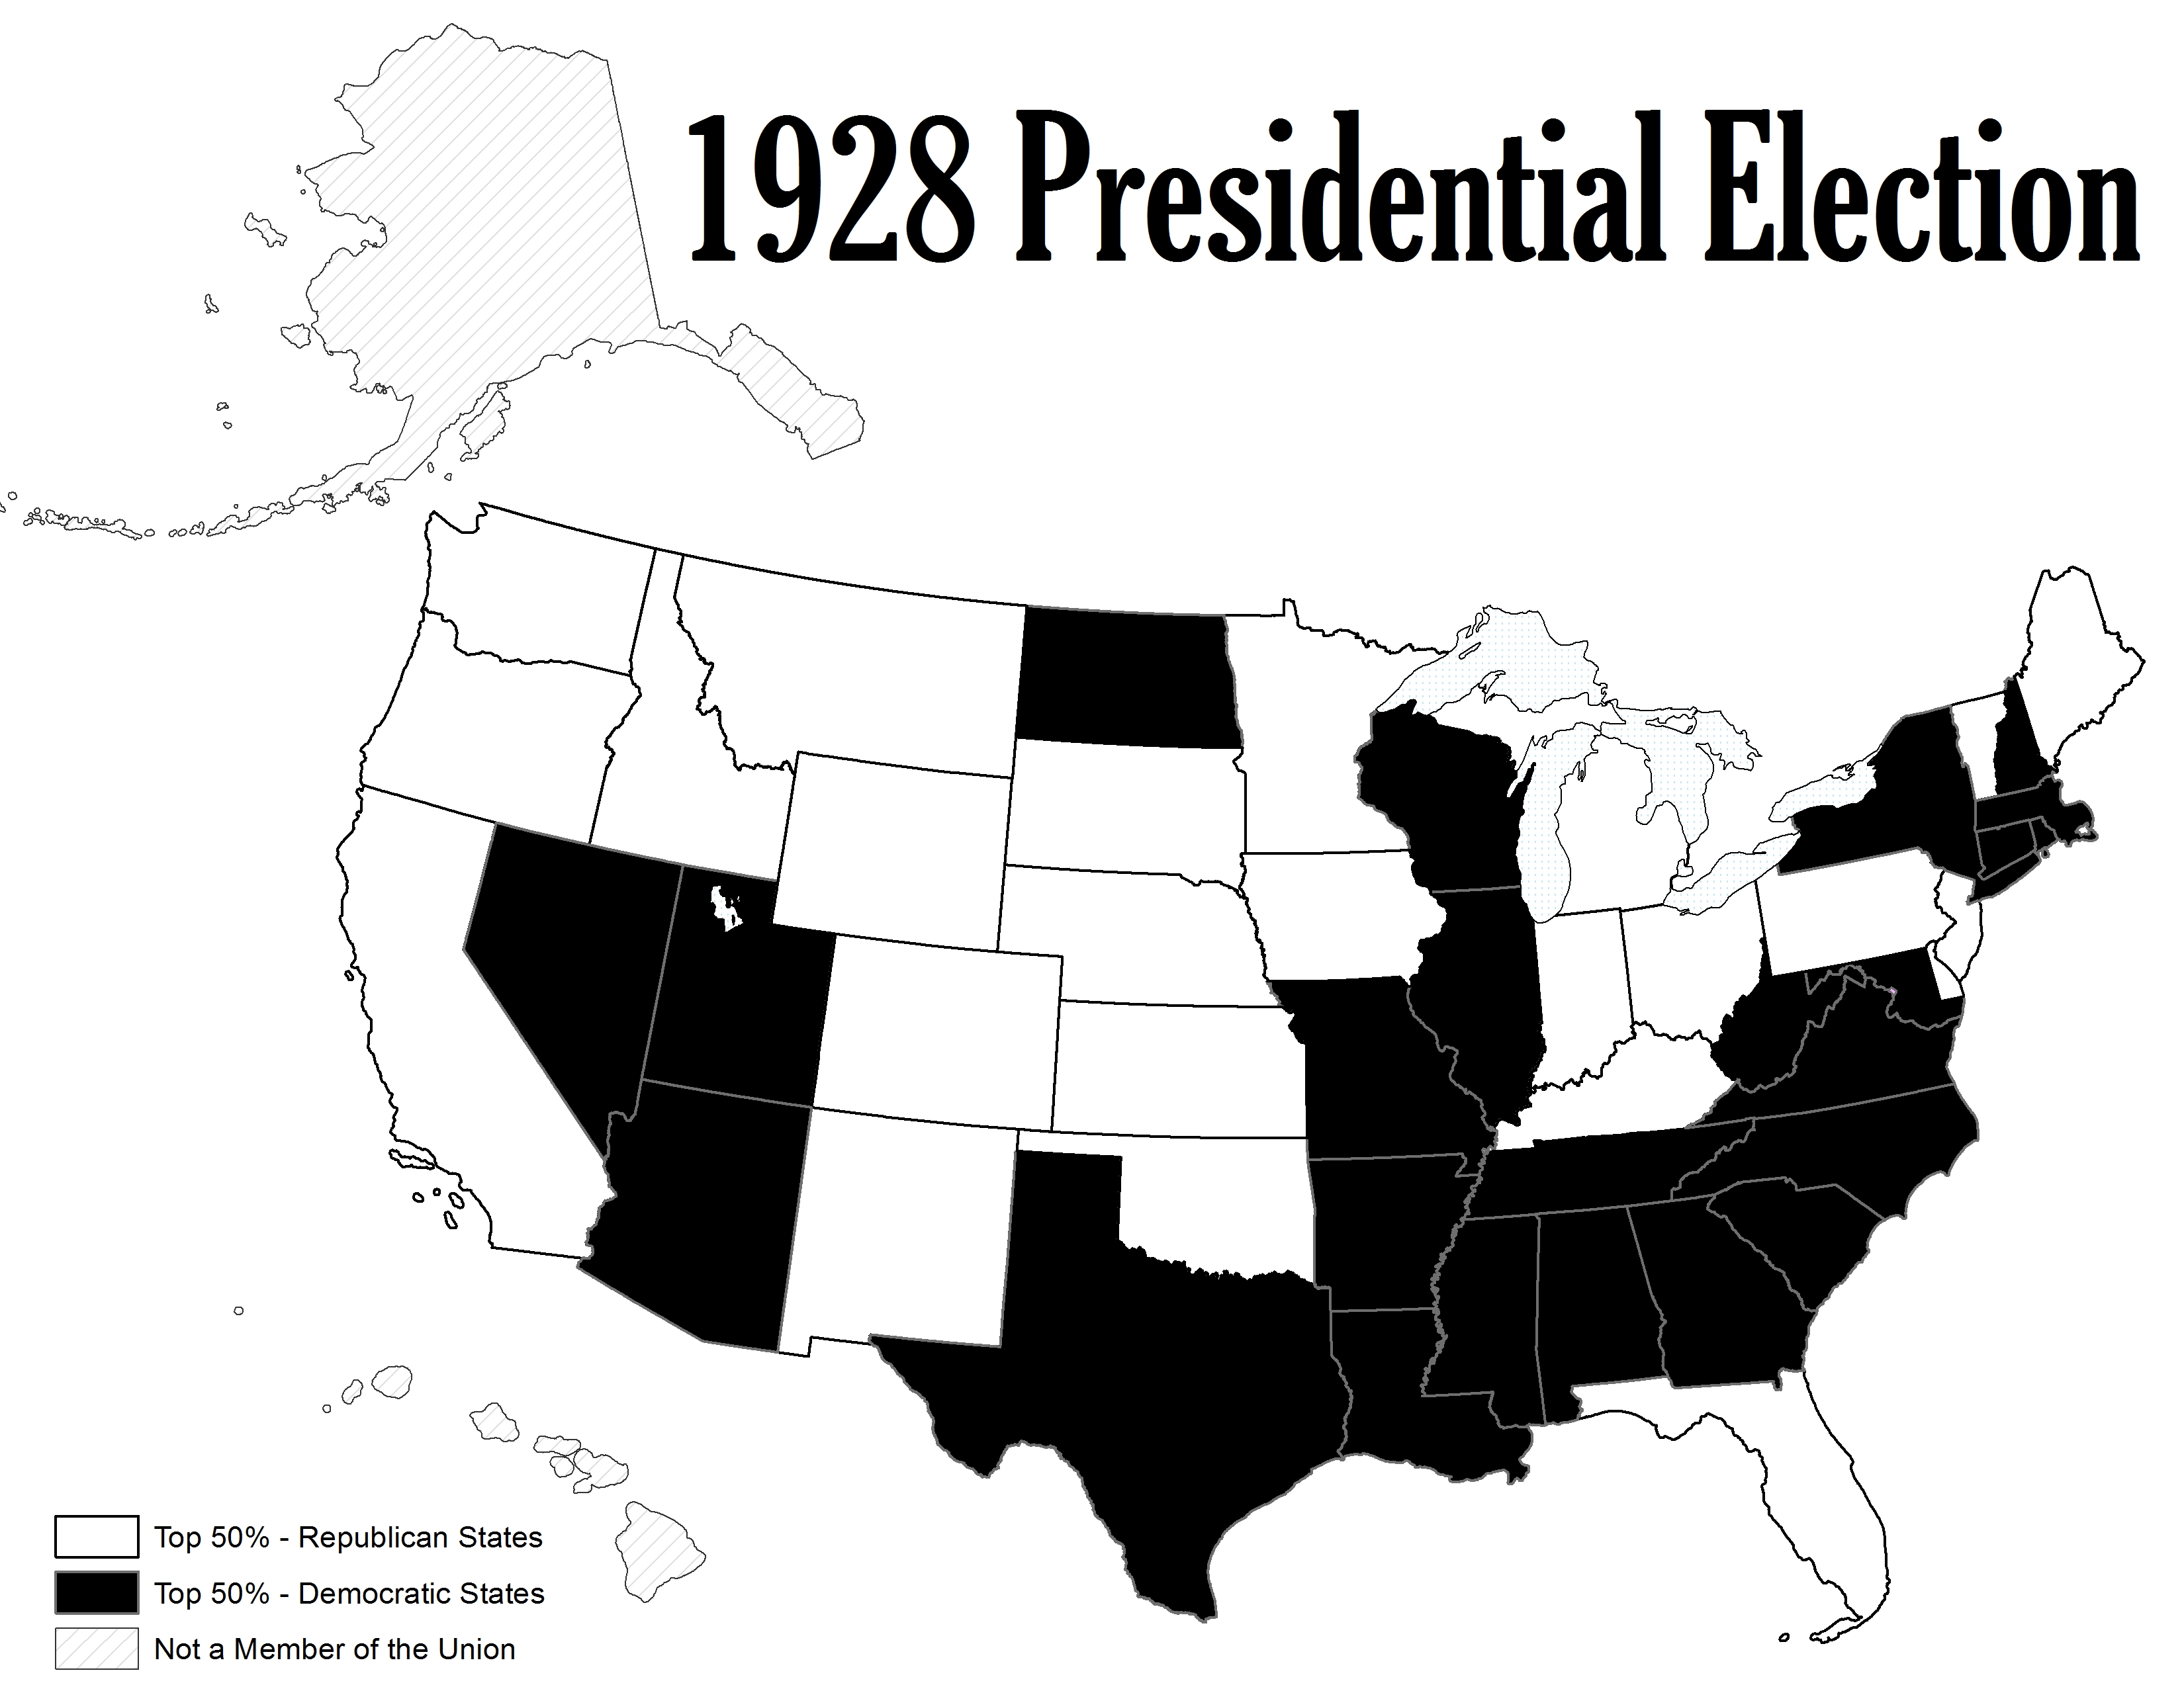

Slide 39
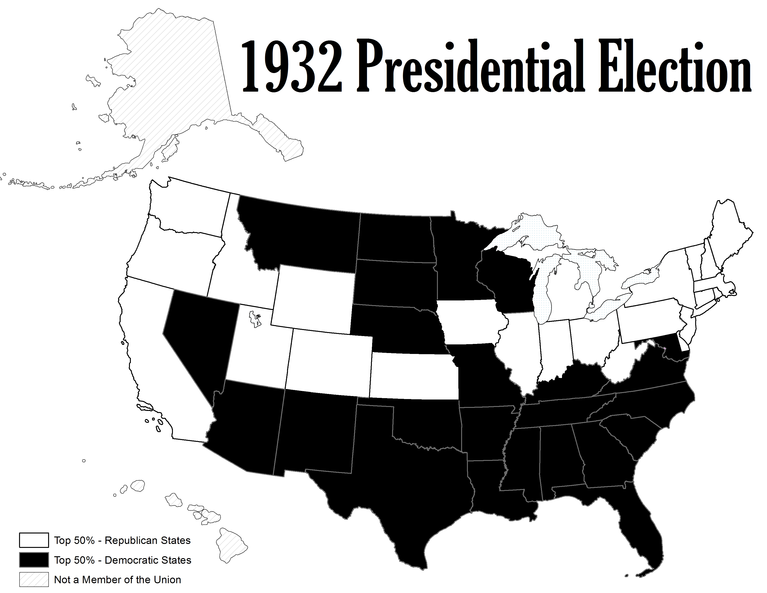

Slide 40
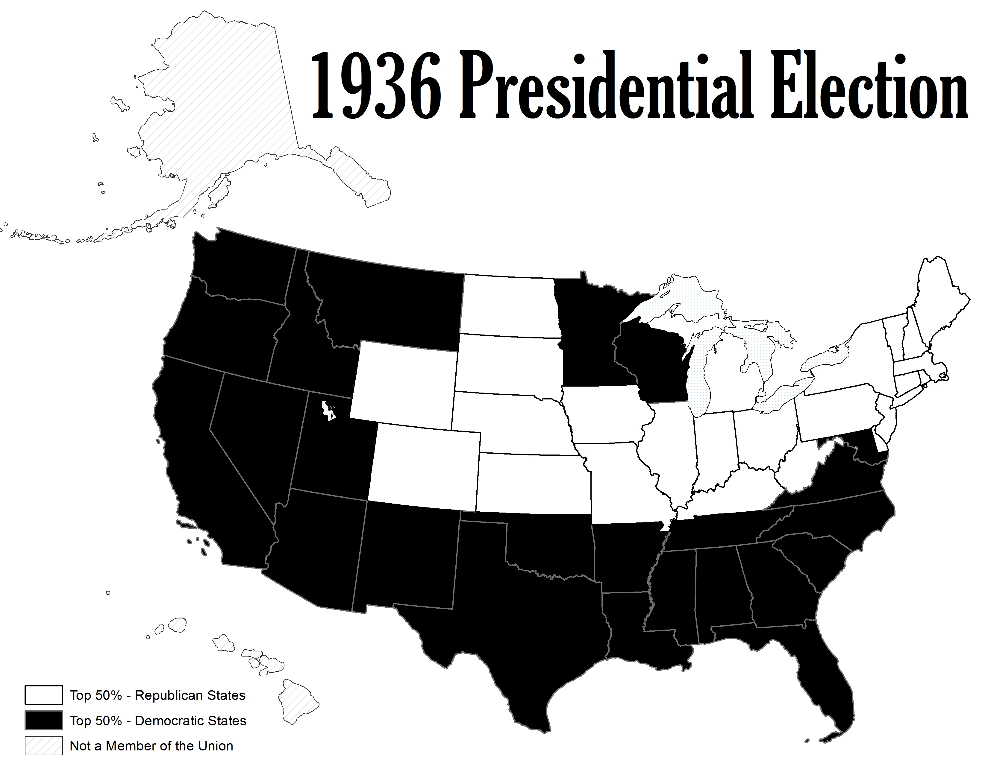

Slide 41
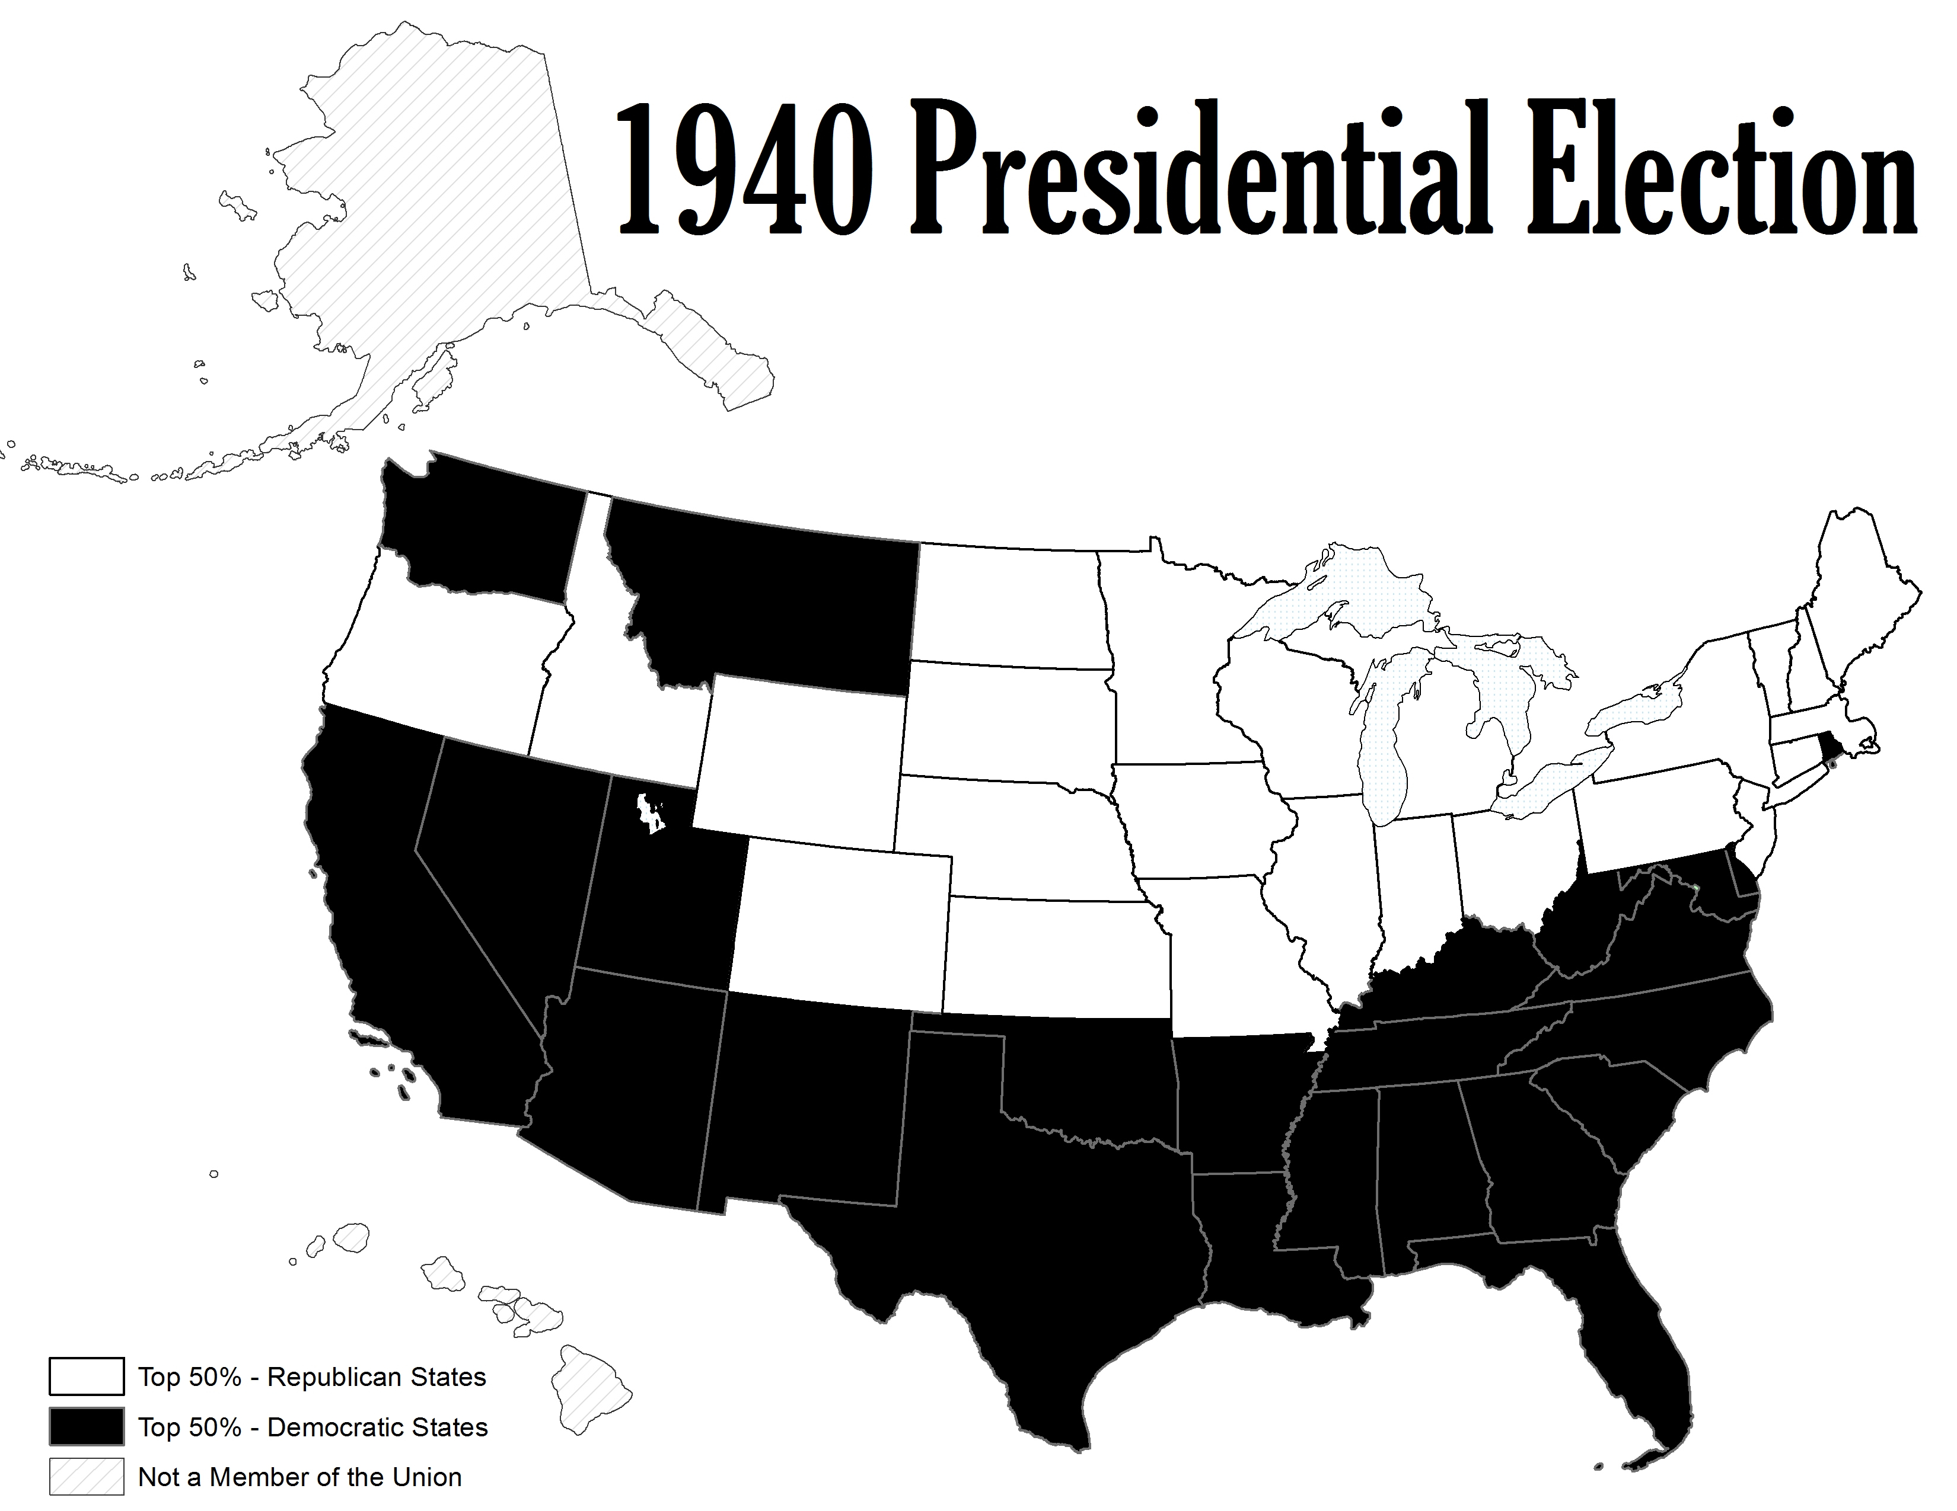

Slide 42
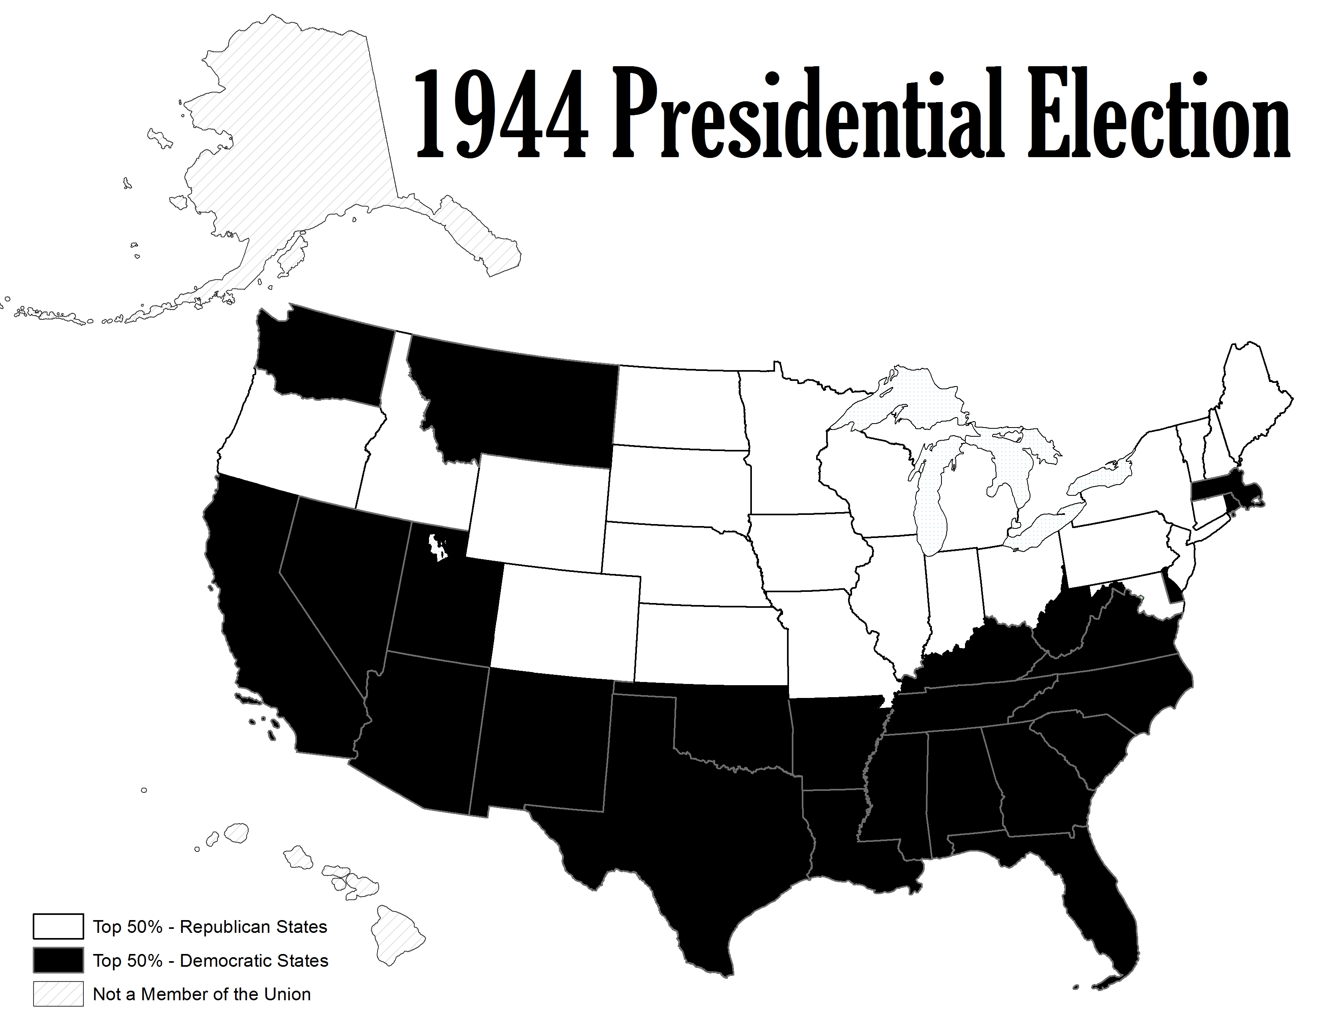

Slide 43
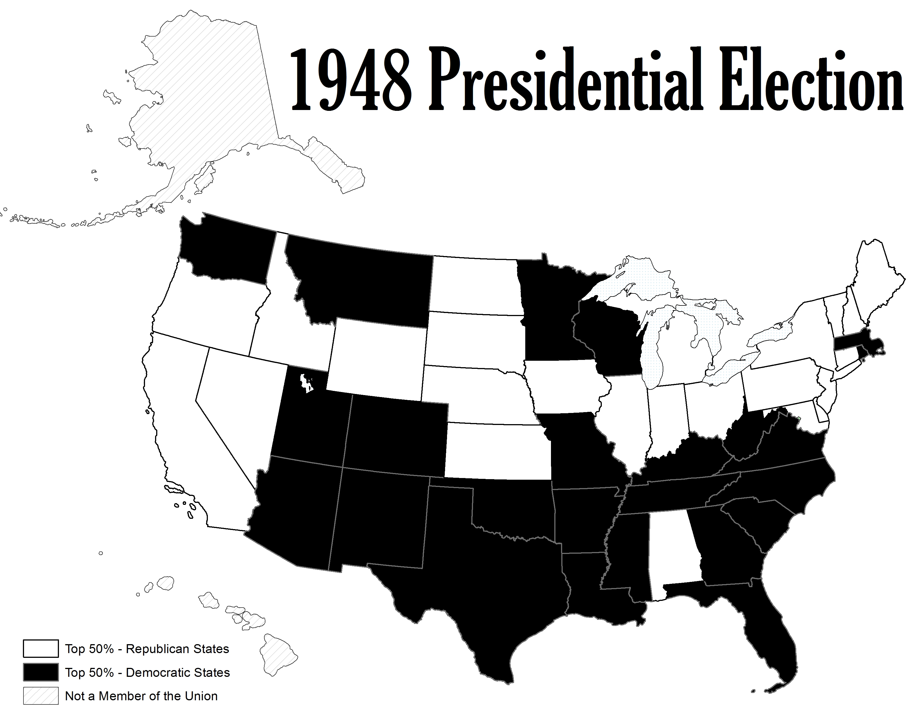

Slide 44
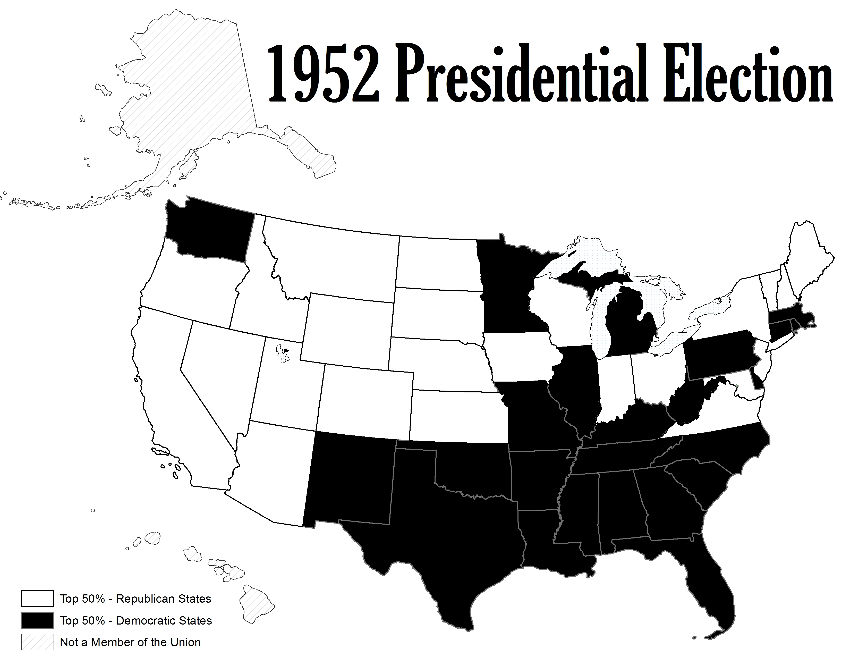

Slide 45
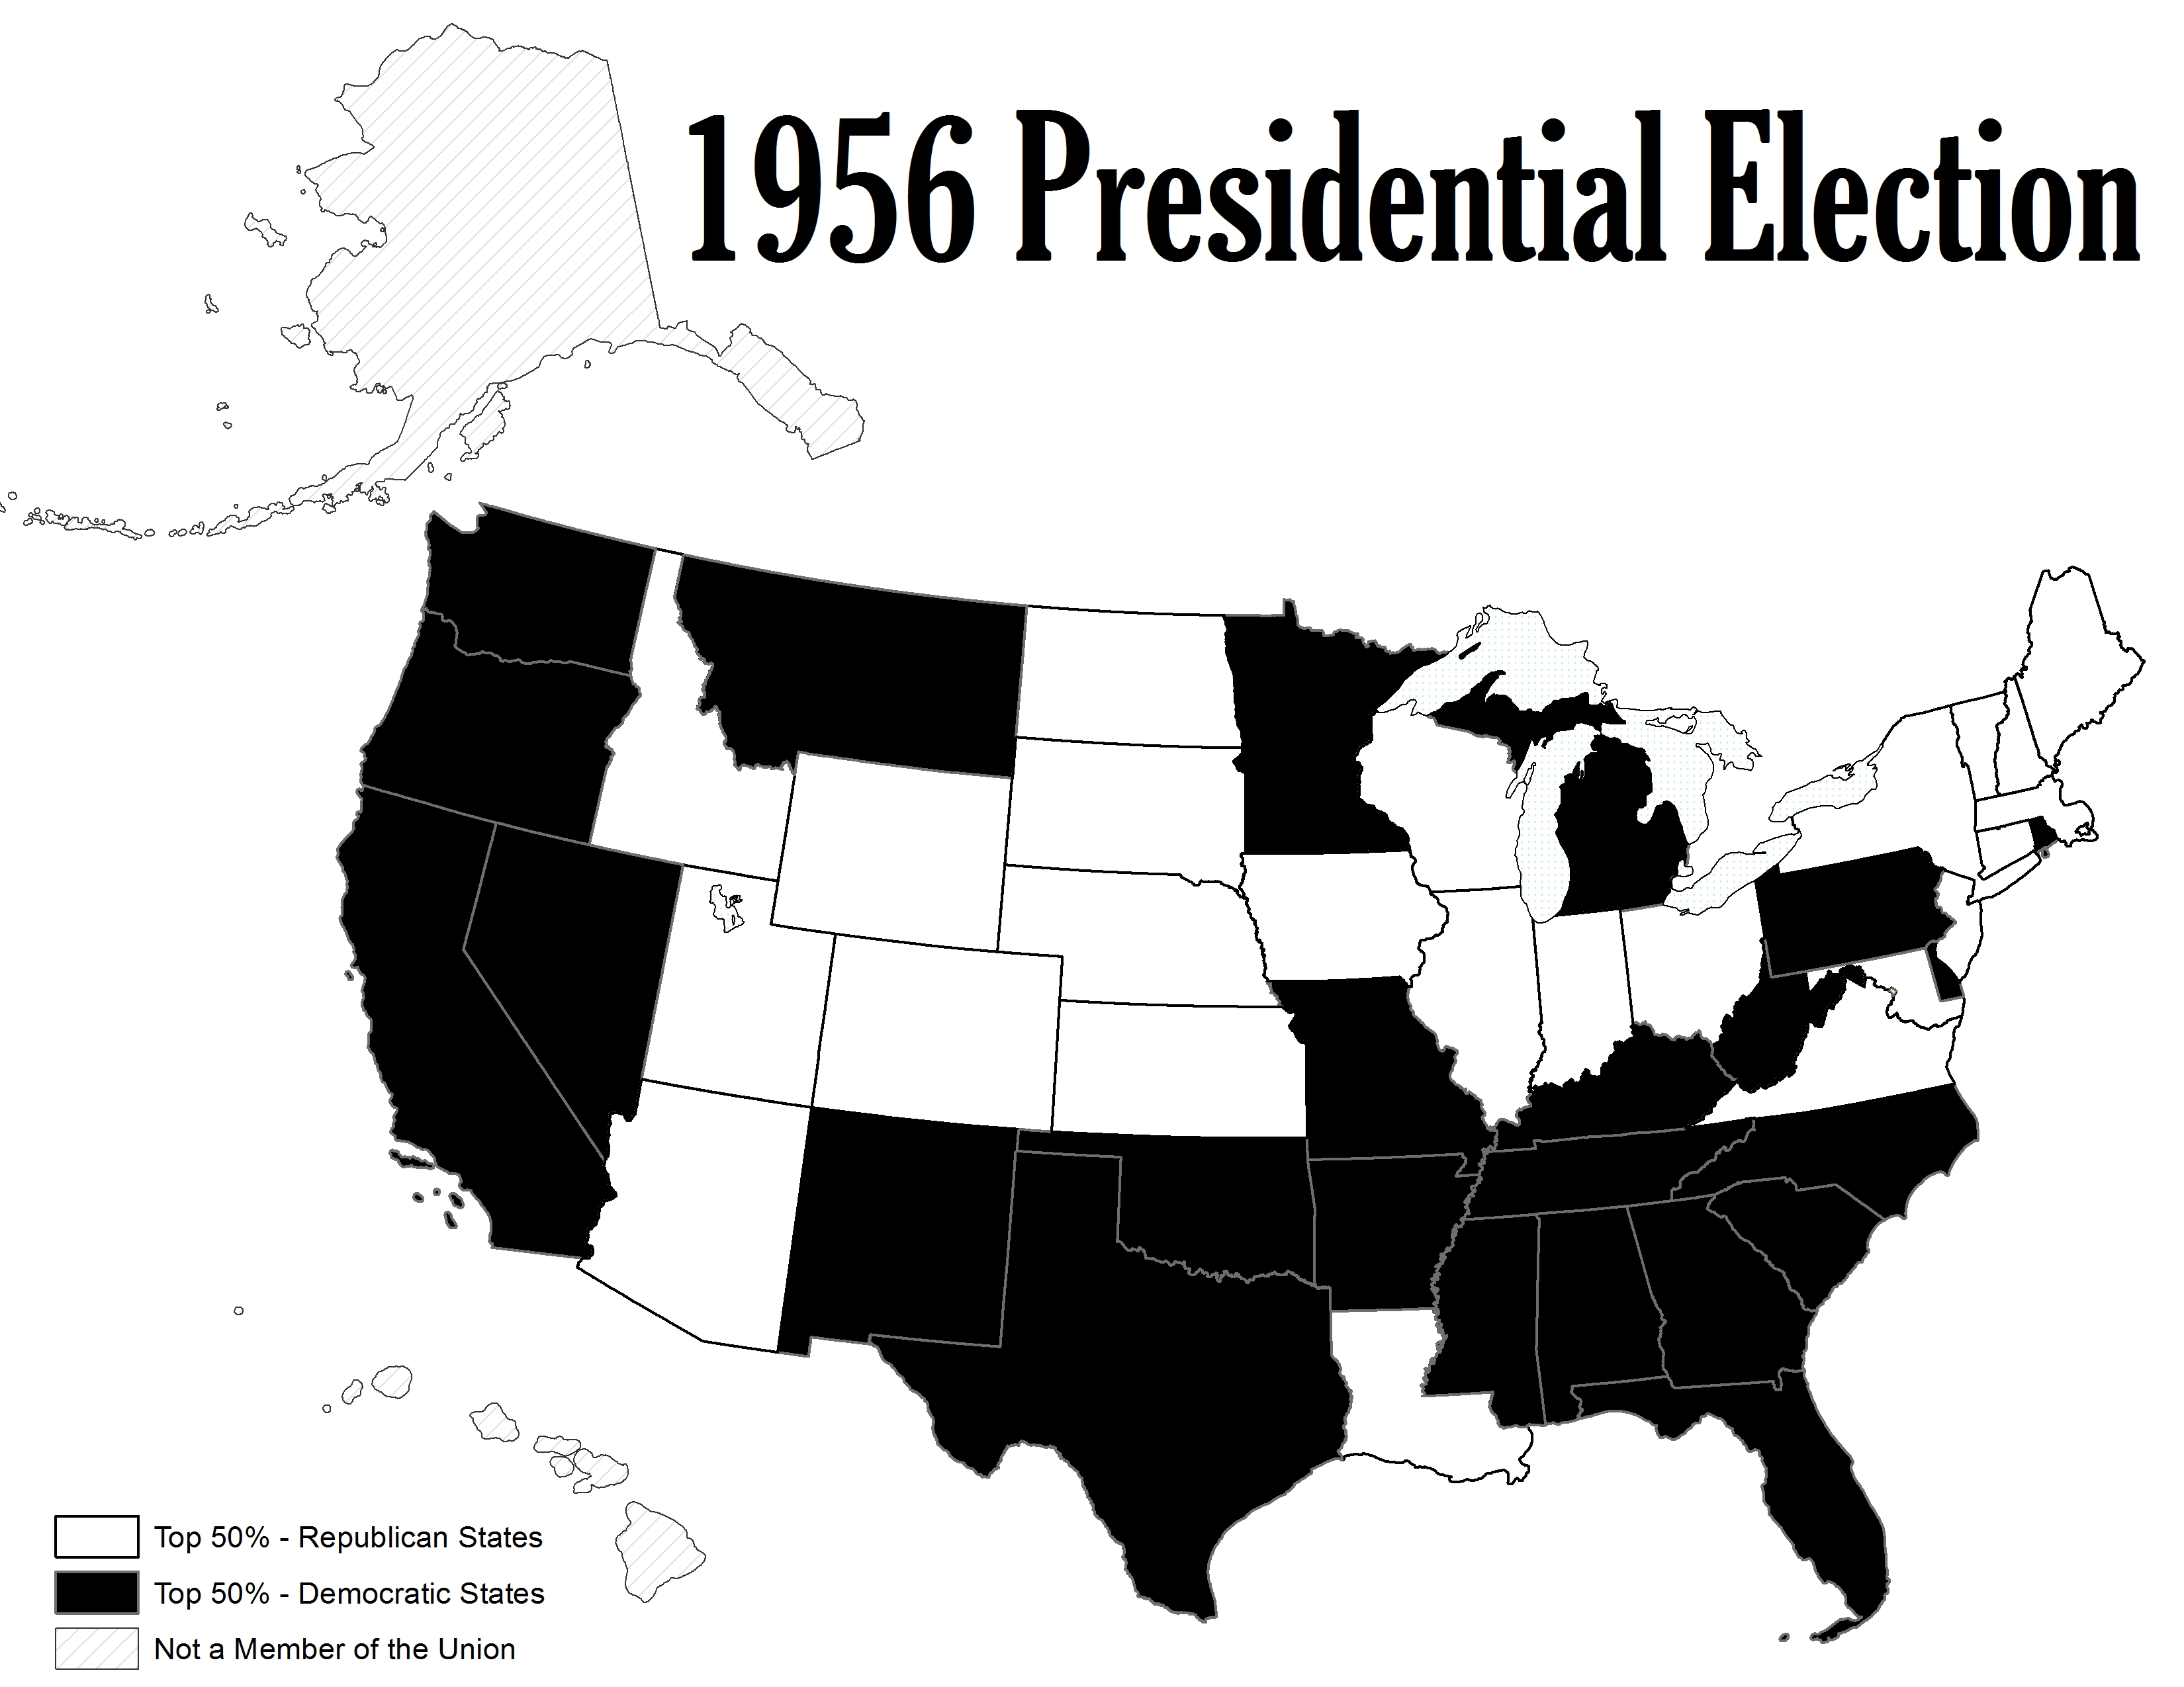

Slide 46
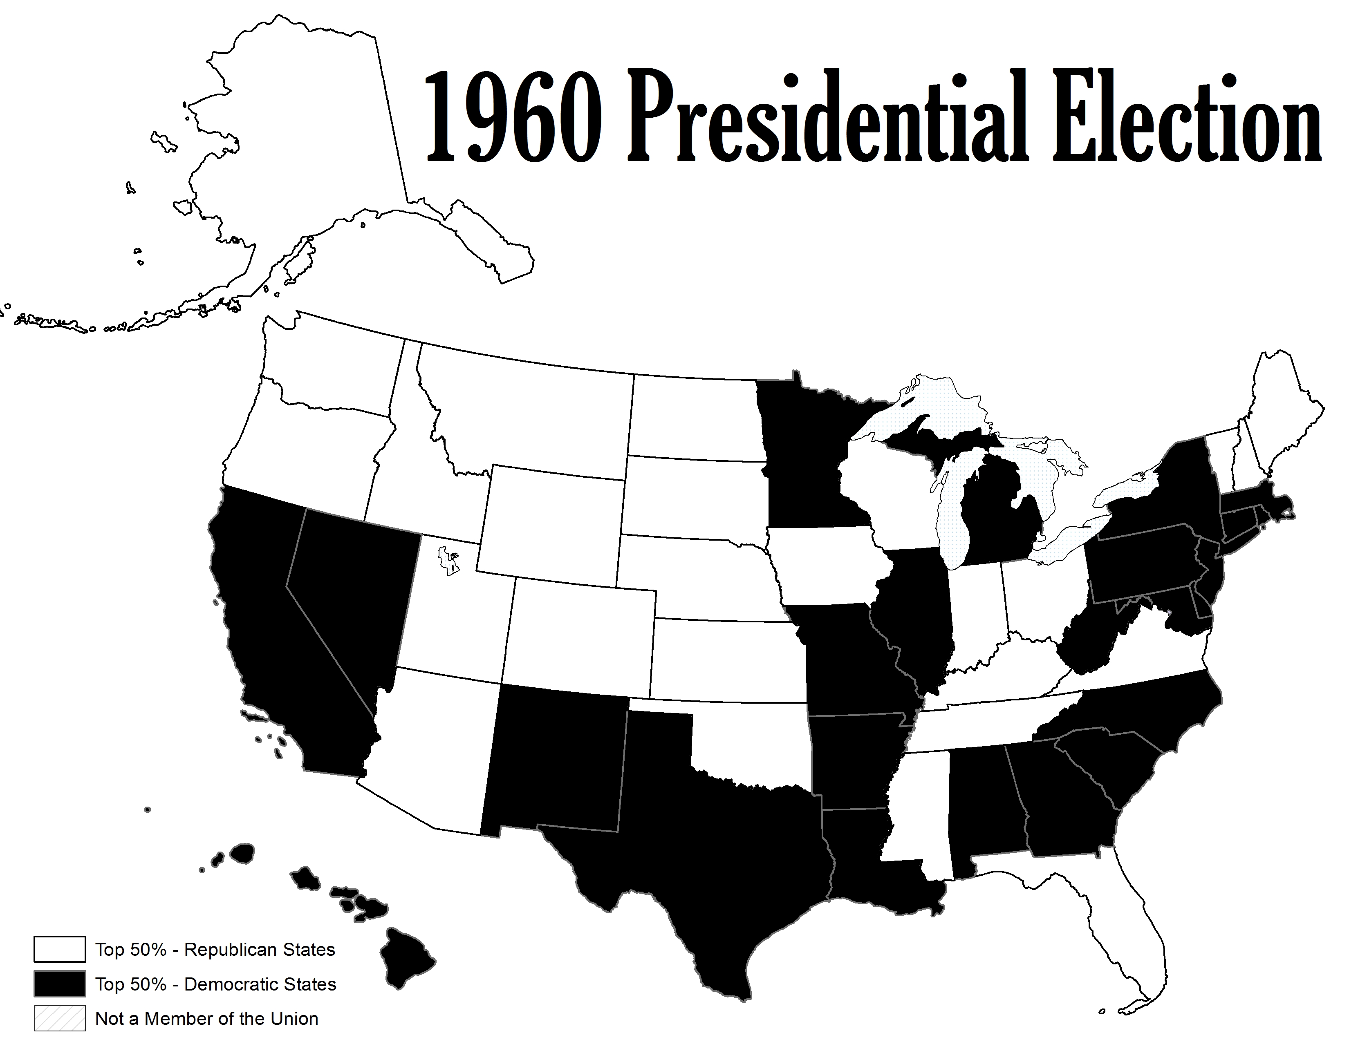

Slide 47
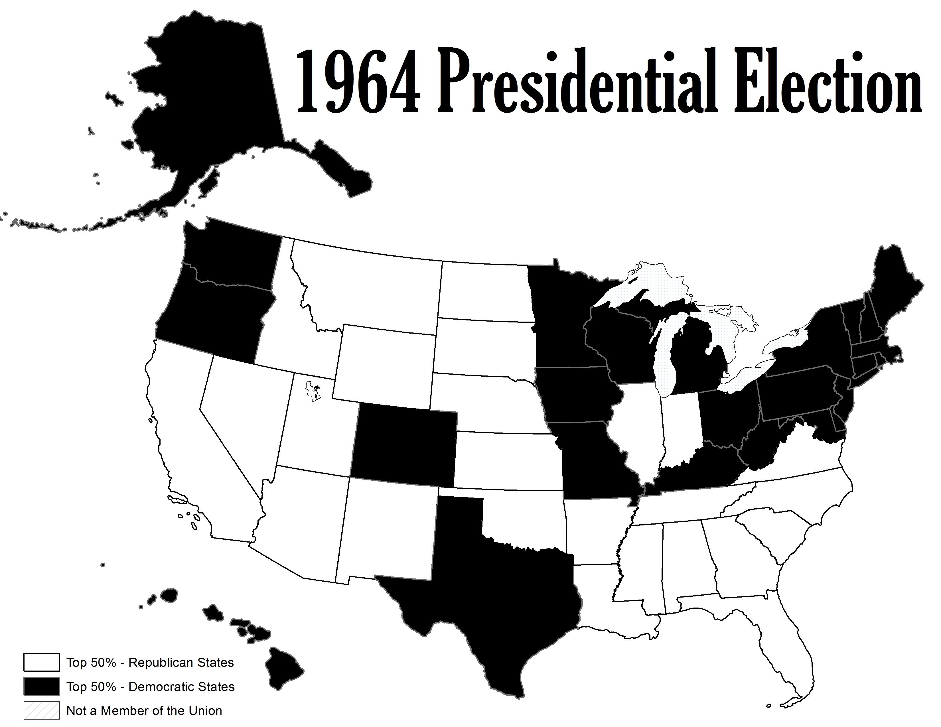

Slide 48
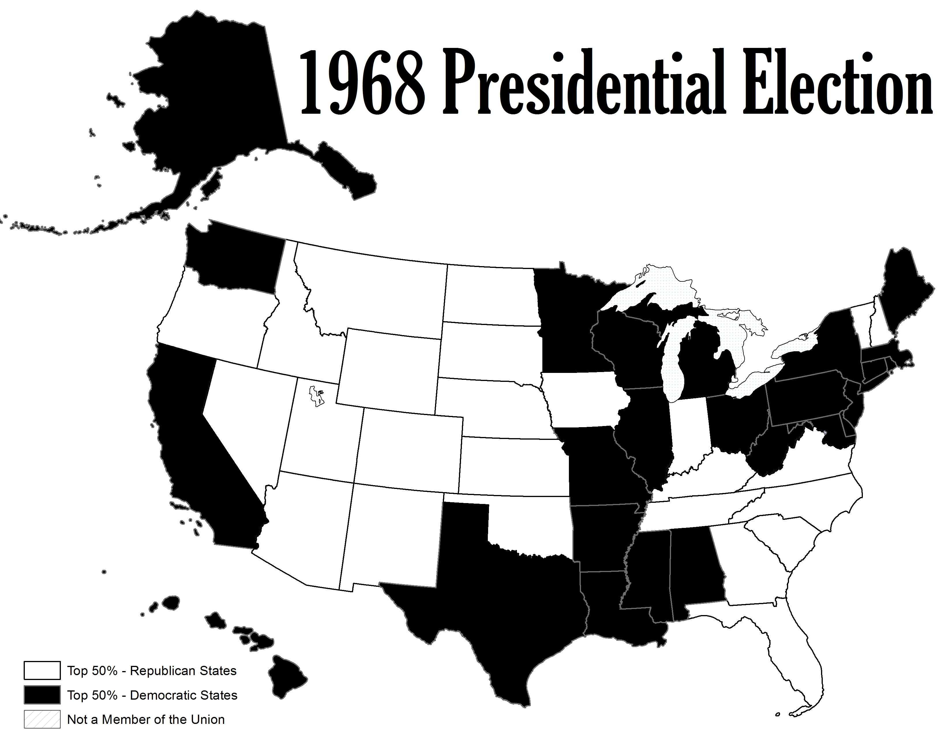

Slide 49
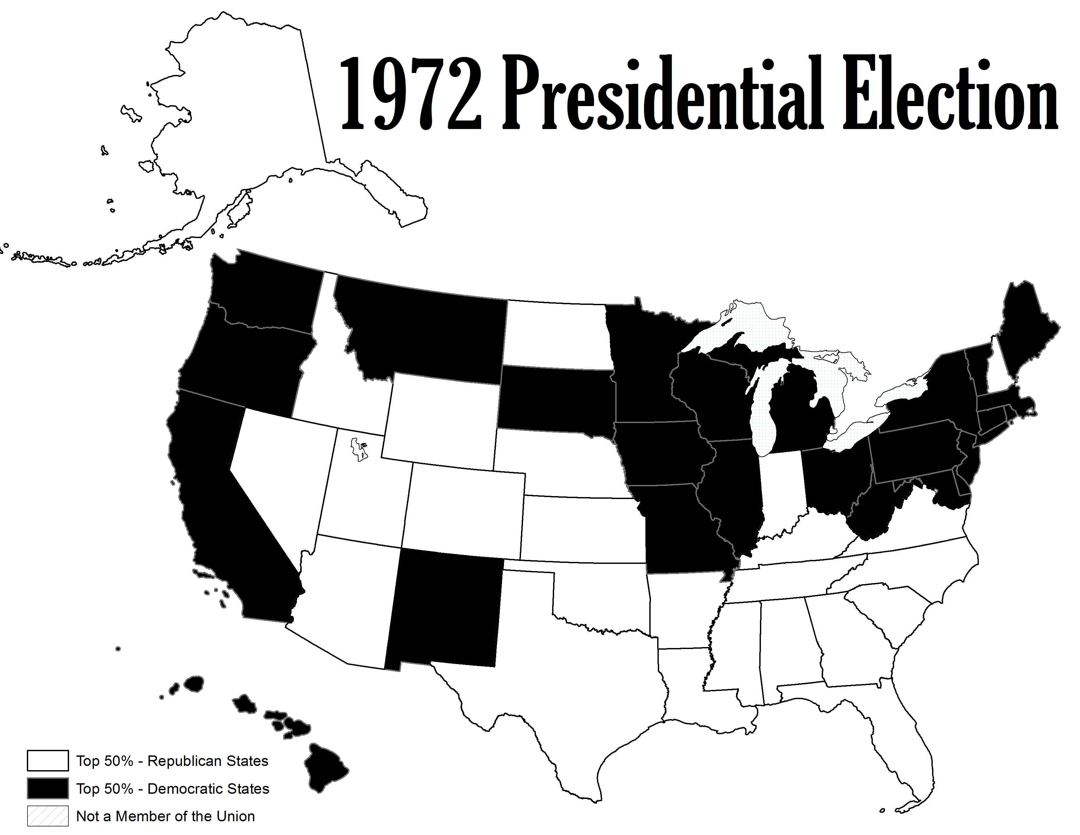

Slide 50
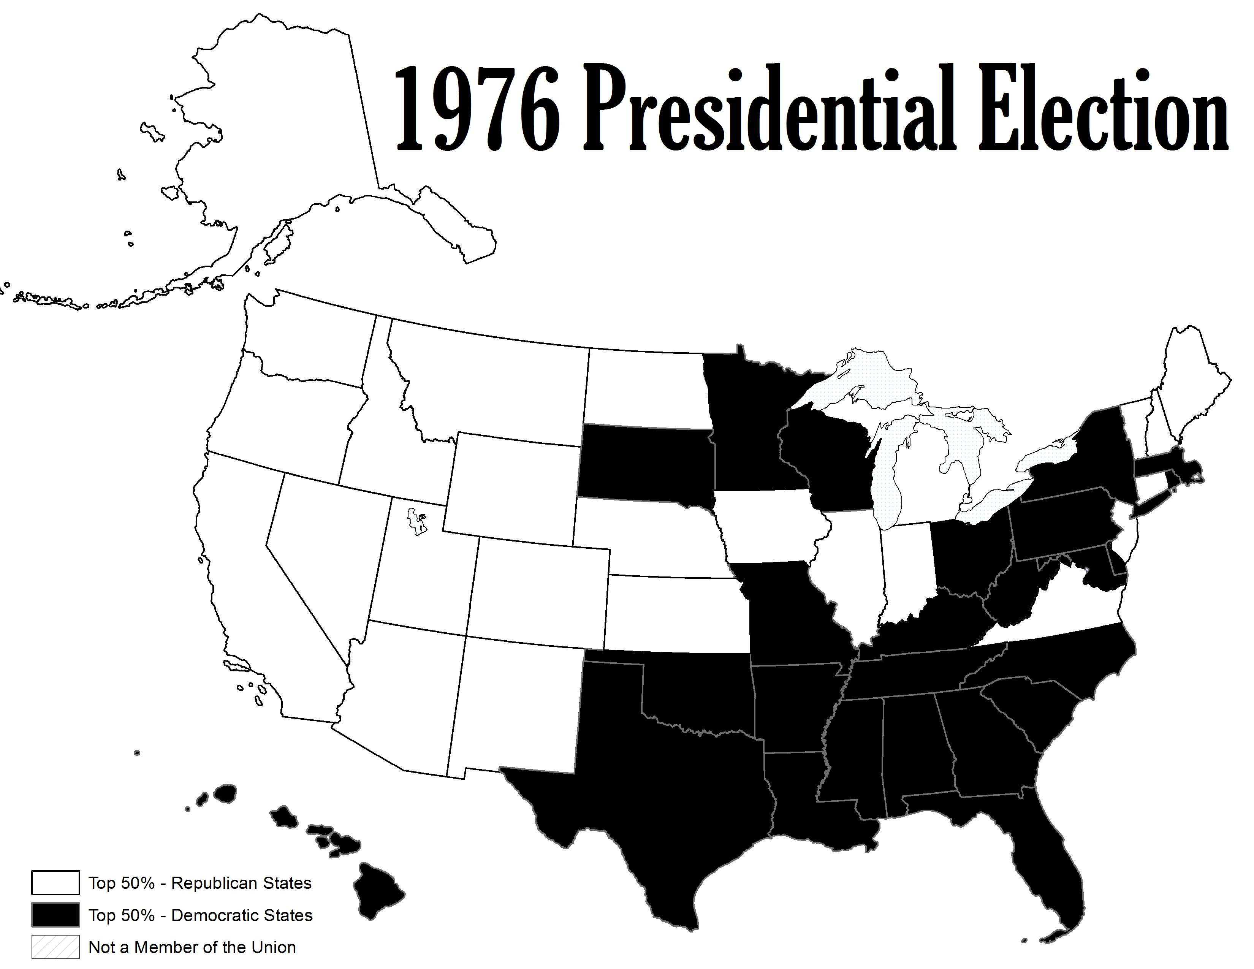

Slide 51
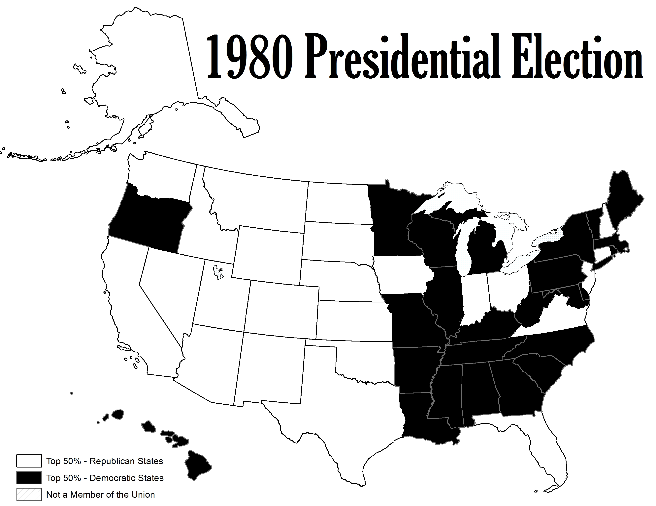

Slide 52
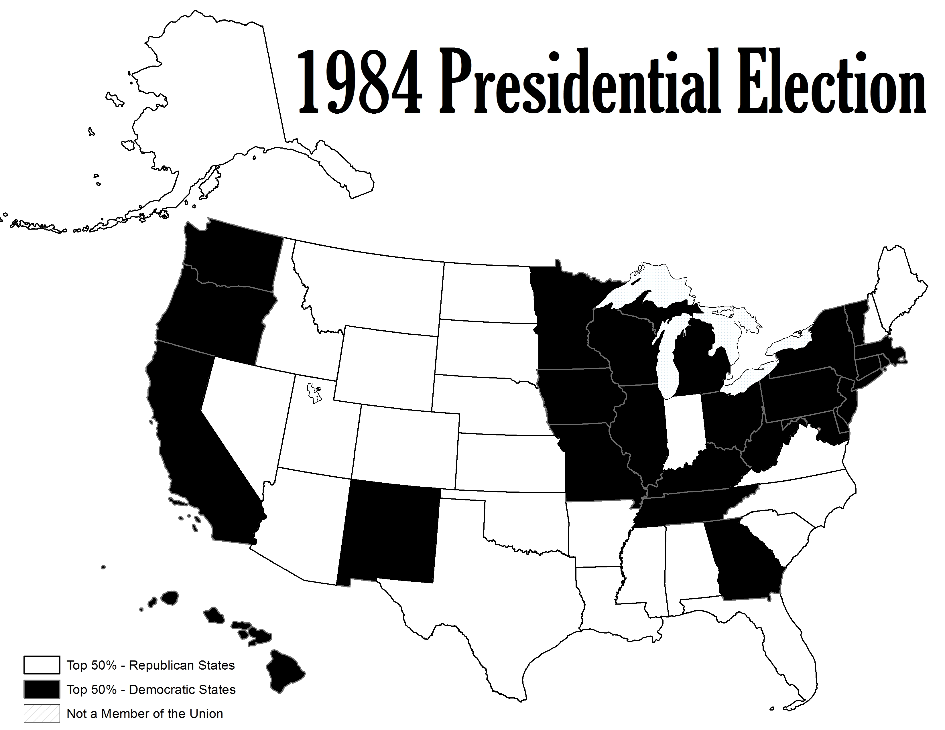

Slide 53
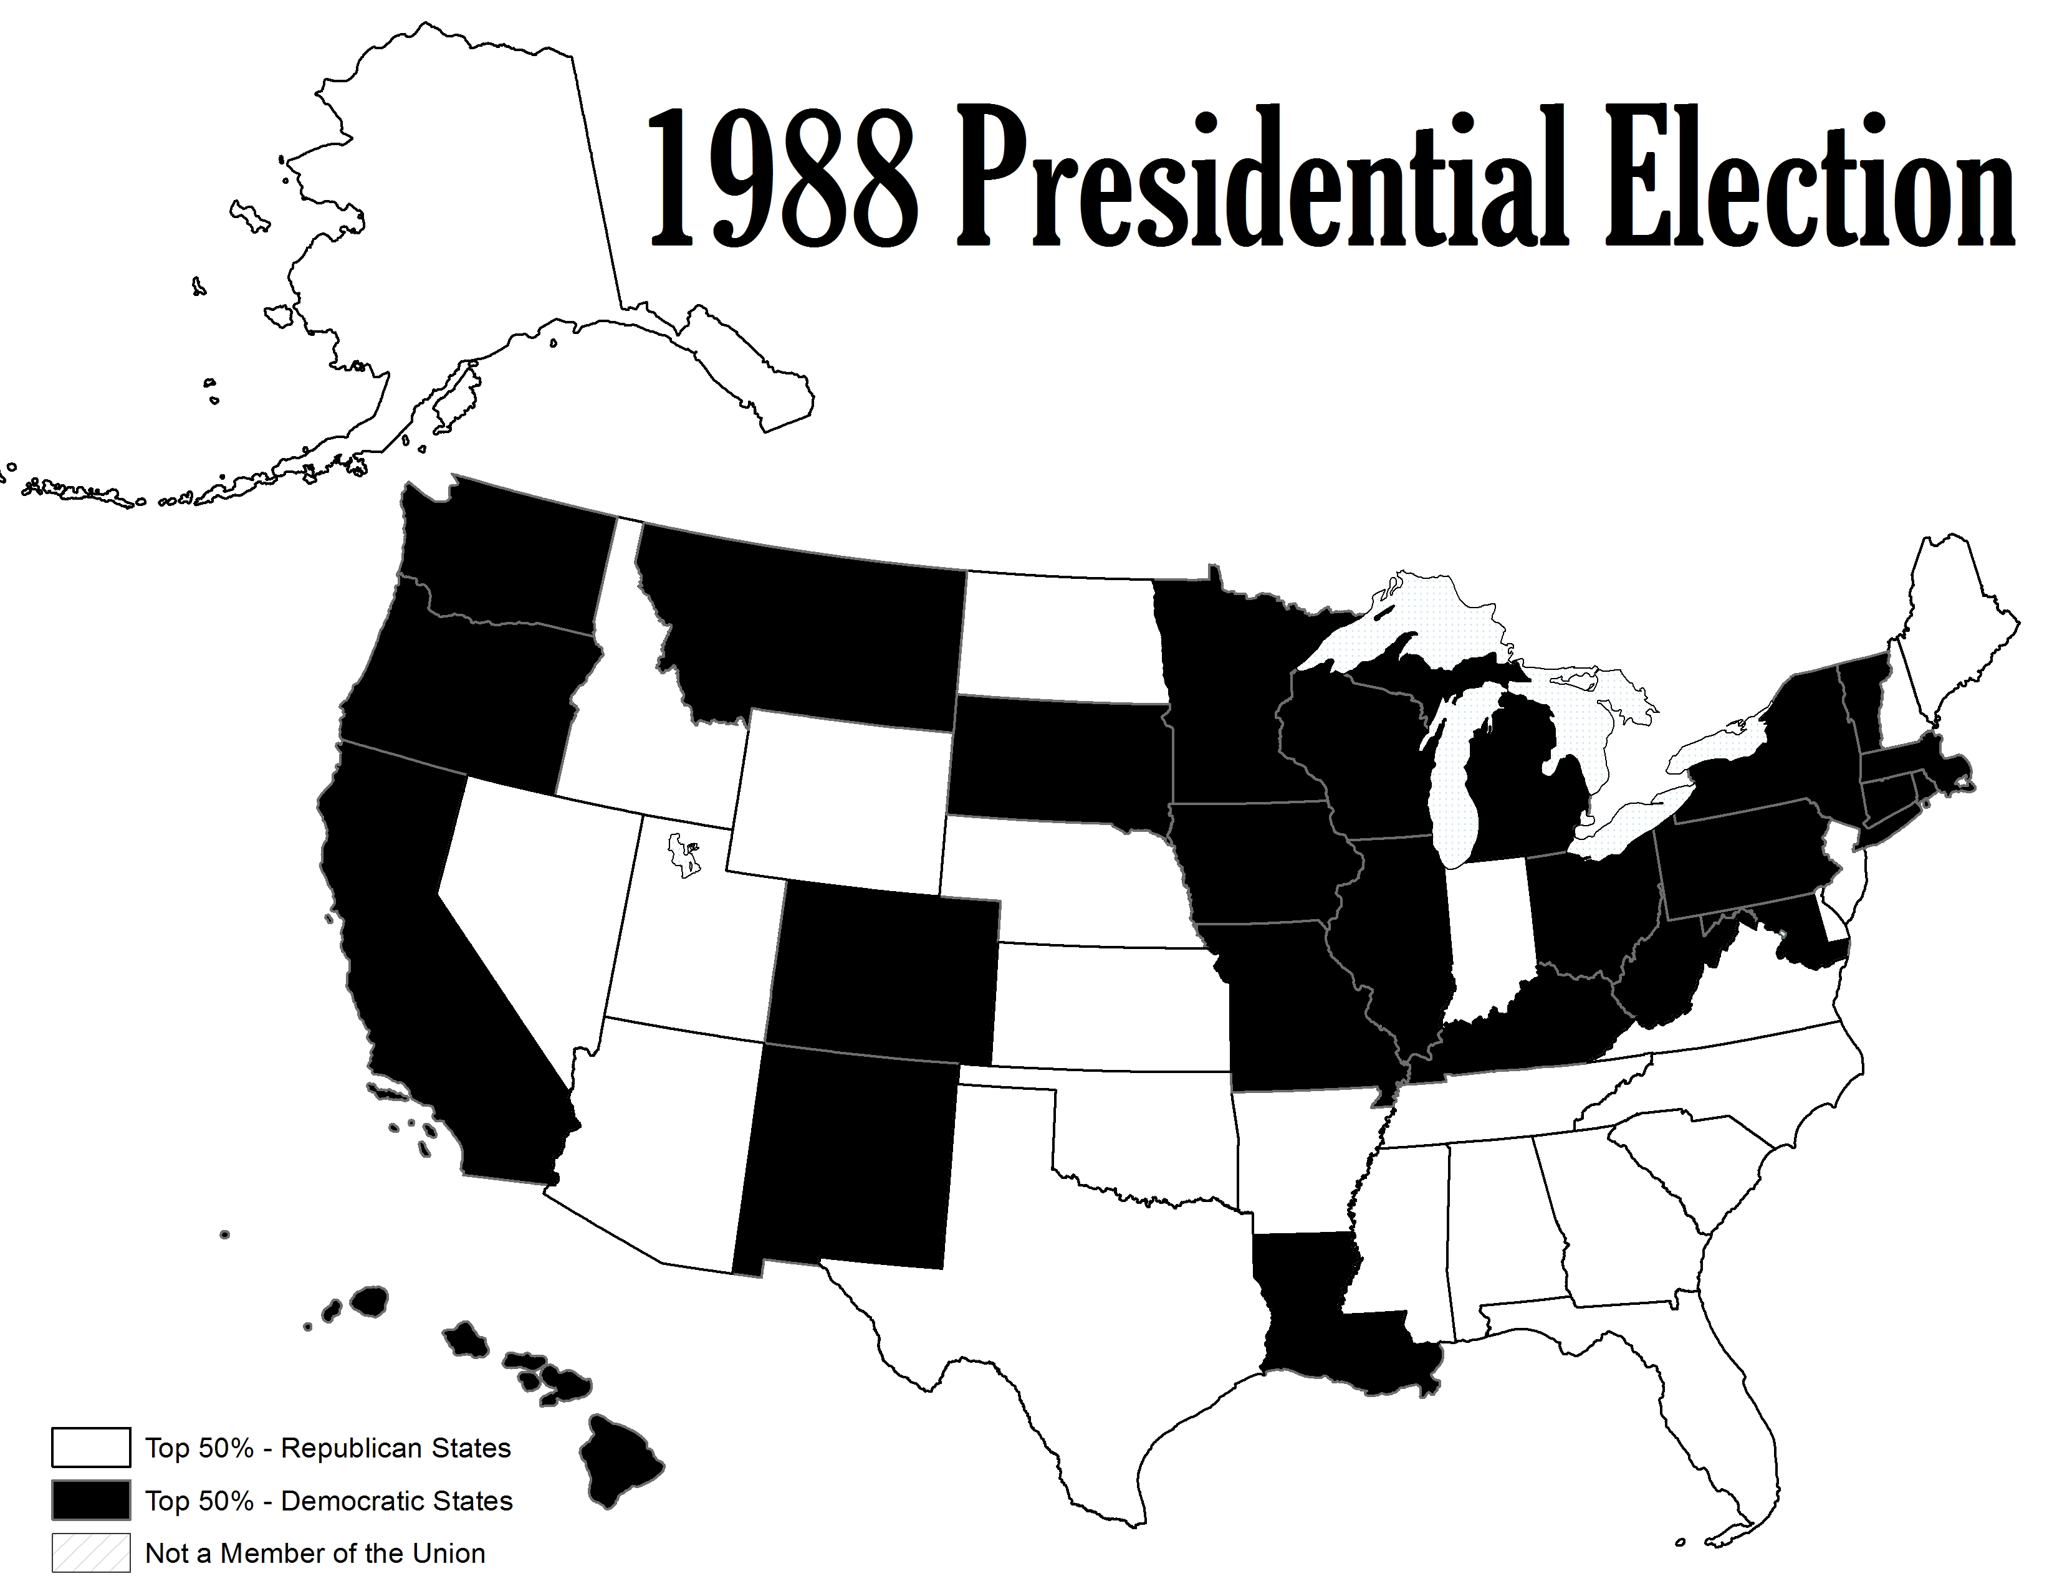

Slide 54
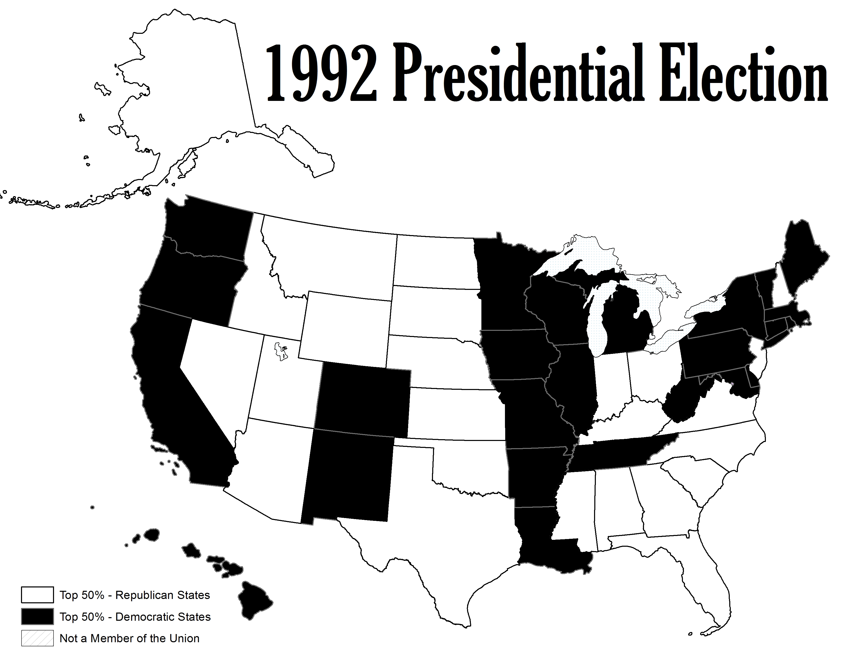

Slide 55
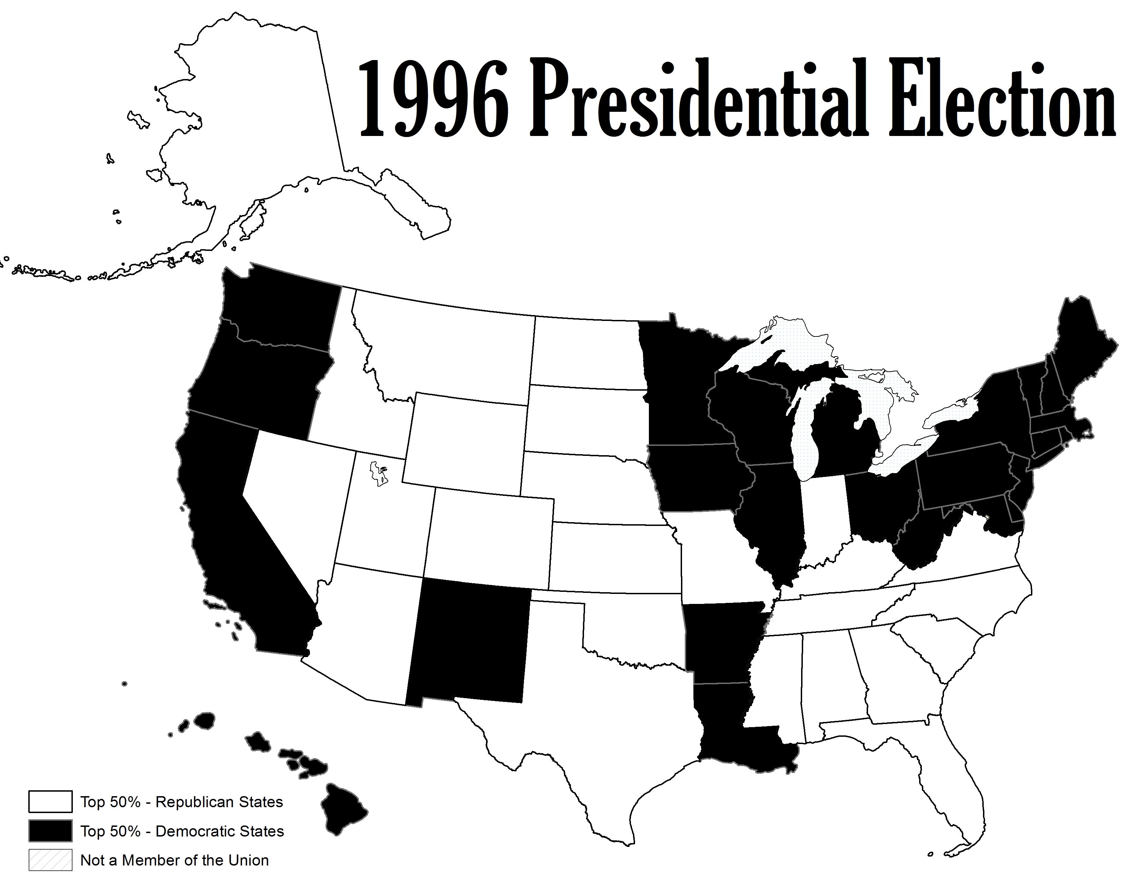

Slide 56
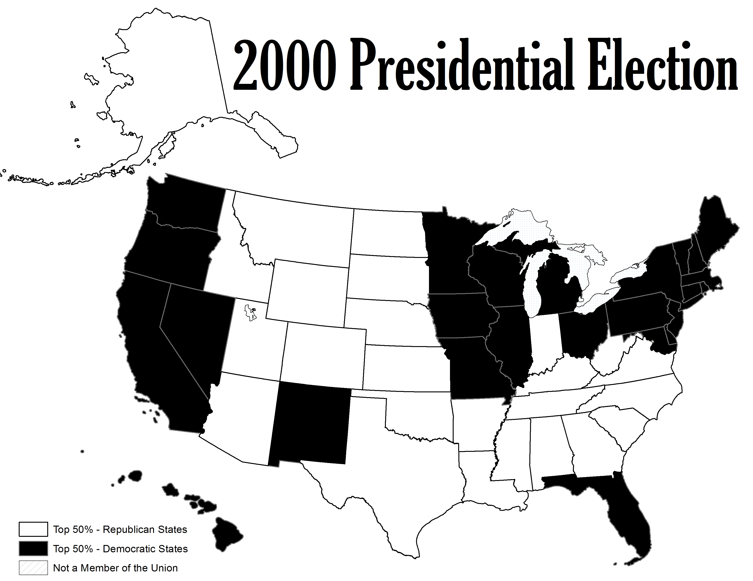

Slide 57
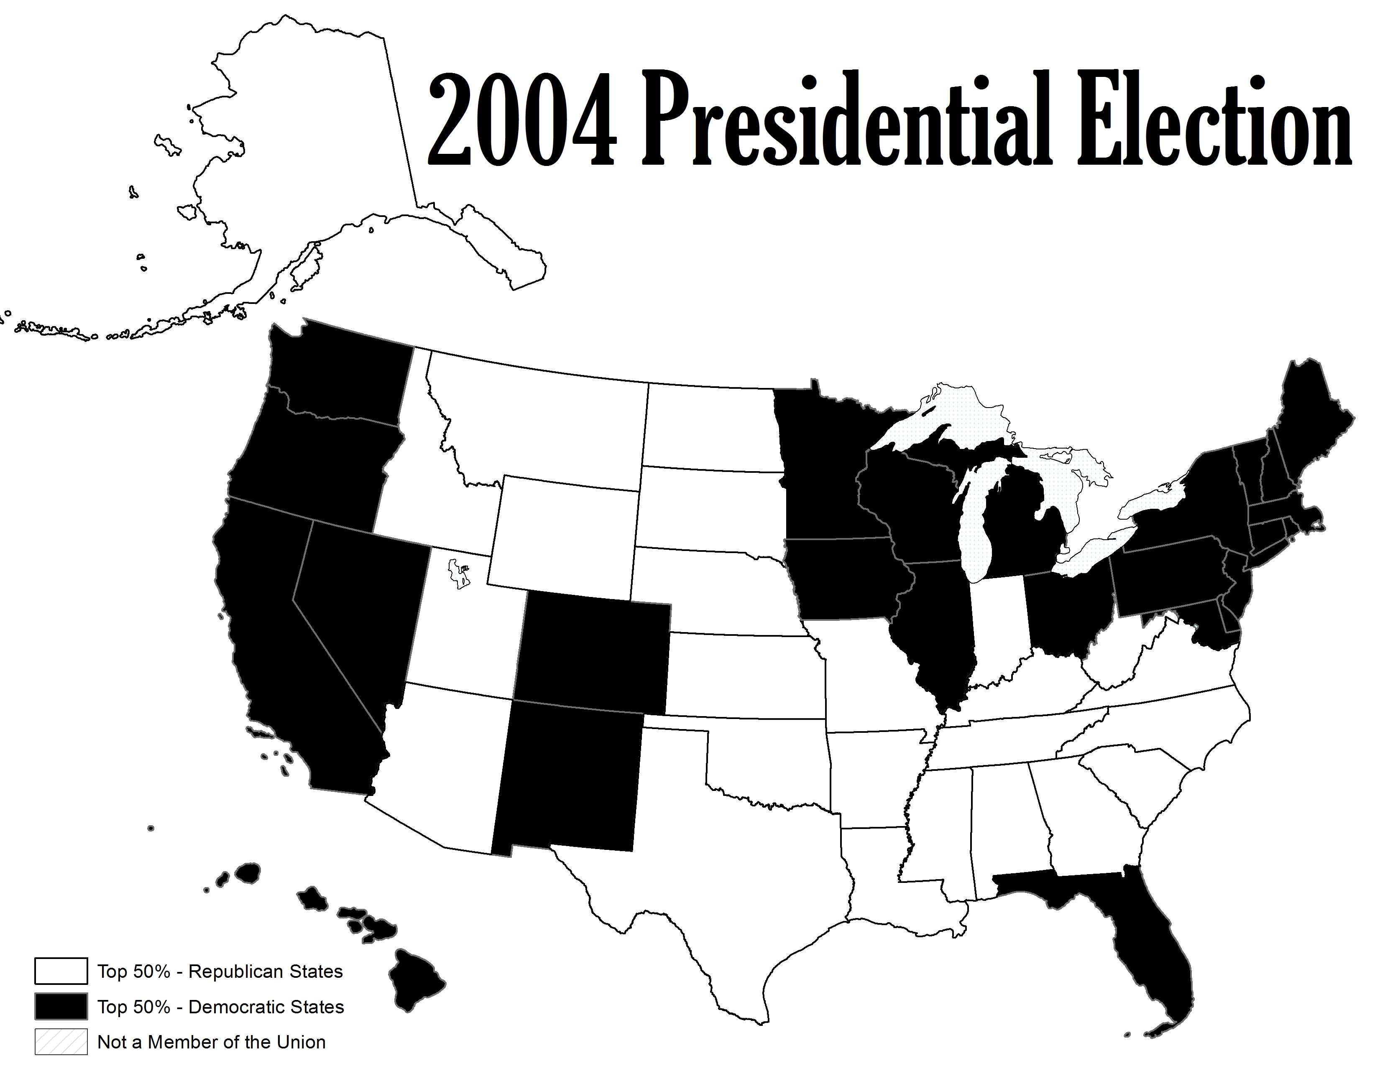

Slide 58
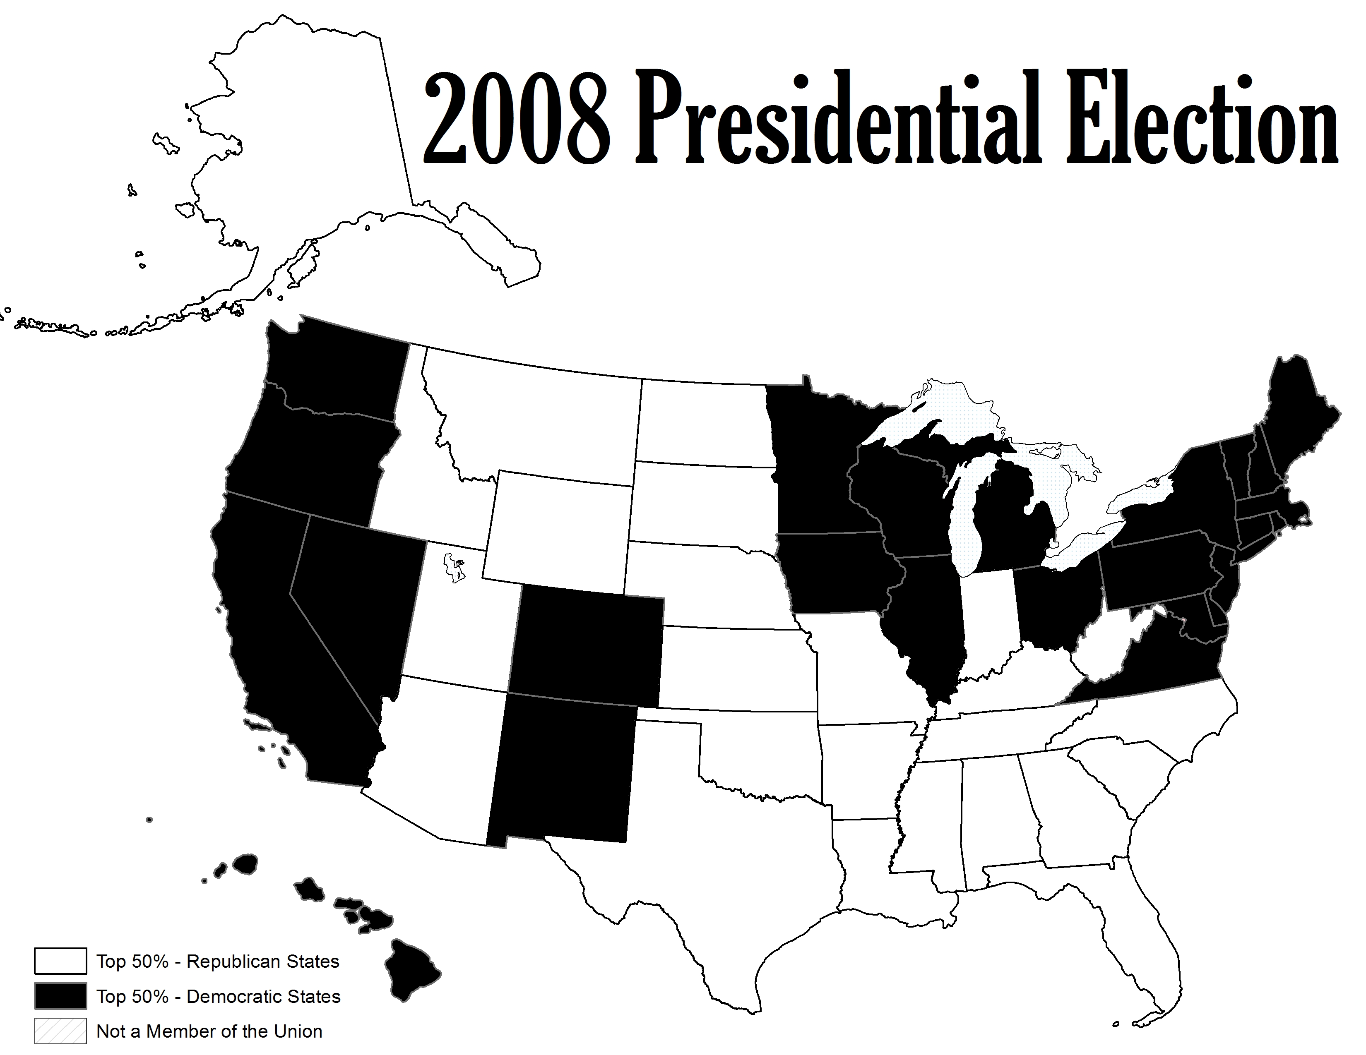

Slide 59


Slide 62
Conclusions
Partisans (including weak partisans) are more likely to vote for their party’s candidate for president.
Parties have helped to sort ideology and partisanship, leading to less split ticket voting.
Geographic sorting has lead to strong partisan states, which then lead to more stable and predictable elections.

Slide 63
